Slide 1


How to read an Athlete’s ECG
Prof Antonio Pelliccia

Slide 2
Learning objectives:
How to interpret the athlete’s ECG
Differentiate ECG features consistent with athletic adaptation from those suggestive of pathology
Determine further evaluation in athletes with specific ECG changes suggestive of pathology

Slide 3
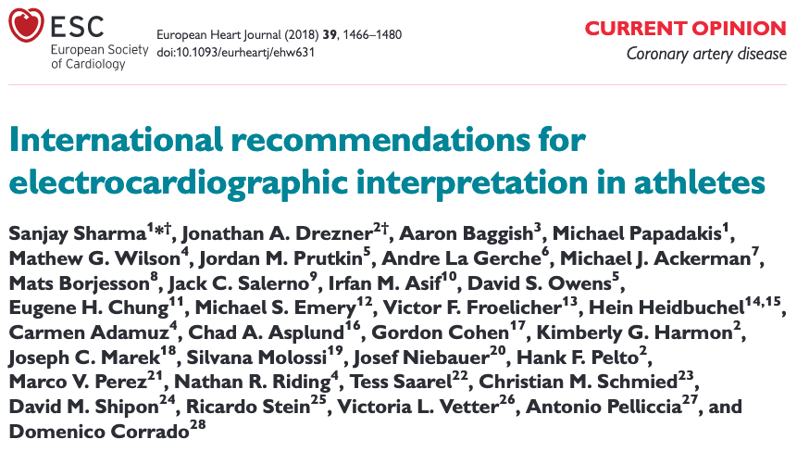
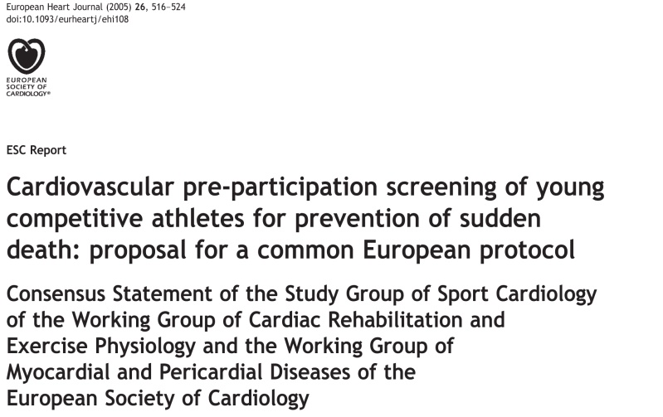



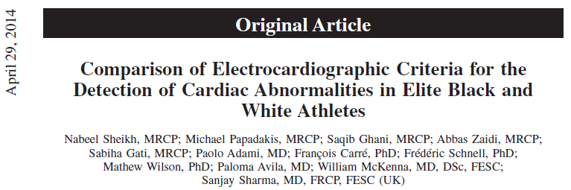

Evolving sensitivity of ECG reading criteria
2005
2010
2013
2014
2017

Slide 5
Sinus Bradycardia, Sinus Arrhythmia
& Junctional Escape Rhythm

Slide 6
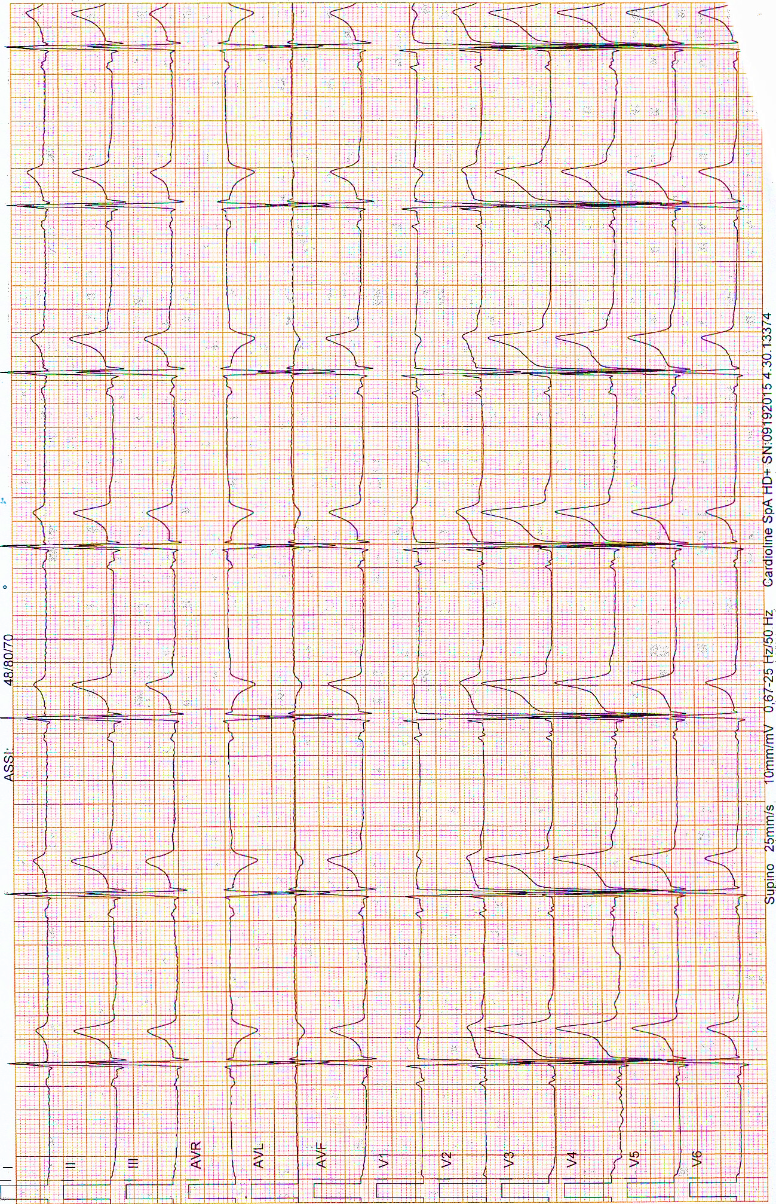
Sinus Bradycardia
27-y.o. male, elite road cyclist
ECG demonstrates sinus bradycardia with a heart rate < 60 bpm.
The features of sinus bradycardia include: 1) P-wave before every QRS complex, 2) normal P-wave axis (frontal plane 0-90 degrees).
ECG demonstrates sinus bradycardia with a heart rate of 37 bpm.

Slide 7
Marked sinus bradycardia (38 bpm)
24-y.o. male, cyclist at PPE

Slide 8
« Is this ECG still normal ? »
The ECG shows a sinus rhythm with 38 bpm:
Yes
No

Slide 9
Marked sinus bradycardia (38 bpm)
24-y.o. male, cyclist at PPE
In the absence of symptoms such as fatigue, dizziness, or syncope, heart rates ≥30 bpm are considered normal in highly trained endurance athletes. Exercise test shows a normal increase of heart rate.

Slide 10
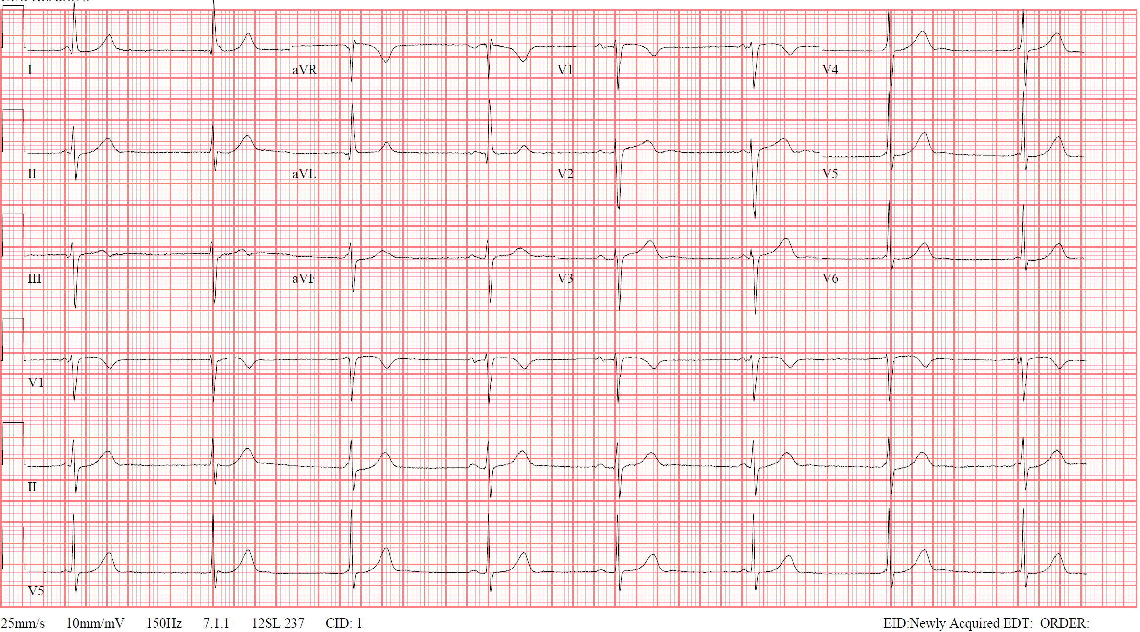
Junctional Escape Rhythm
Constant RR
Constant RR
Constant RR
PP 1340 ms
PP 1360 ms
PP 1220ms
PR
PR
PR
PR
The first beat shows a normal PR interval of 190 ms.
The second and third beats show a shortening of the PR interval (110ms and 30ms, respectively). The QRS comes from the junctional escape beat.
Note the P-wave on the third beat blends into the QRS and mimics a delta wave.

Slide 11
1st Degree AV Block &
2nd Degree AV Block, MobitzType I

Slide 12
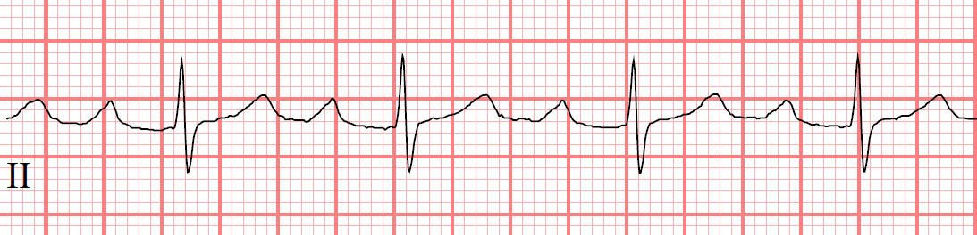
1st Degree AV Block
PR
18-y.o. female, basketball player at PPE
The PR interval is measured from the beginning of the P-wave to the beginning of the R-wave.
The PR interval is constant from beat to beat and measures 300 ms.

Slide 13
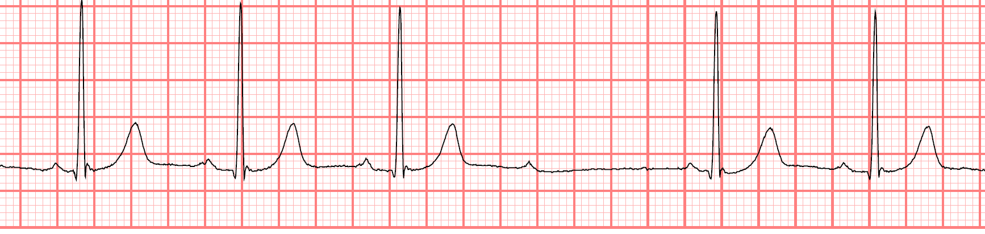
Mobitz Type I (Wenckebach) 2° AVB
21-y.o. male, rower at PPE
PR 140 ms
PR 190 ms
PR 200 ms
P
PR 140 ms
PR 190 ms
2nd degree AV block, Mobitz Type I (Wenckebach) is demonstrated by progressively longer PR intervals until a dropped QRS. The PR interval on the first three beats are 140 ms, 190 ms, and 200 ms, respectively.
The fourth P wave has no QRS complex following it.
The PR interval after the fifth P wave is 140 ms again.

Slide 14
Incomplete Right Bundle
Branch Block

Slide 15
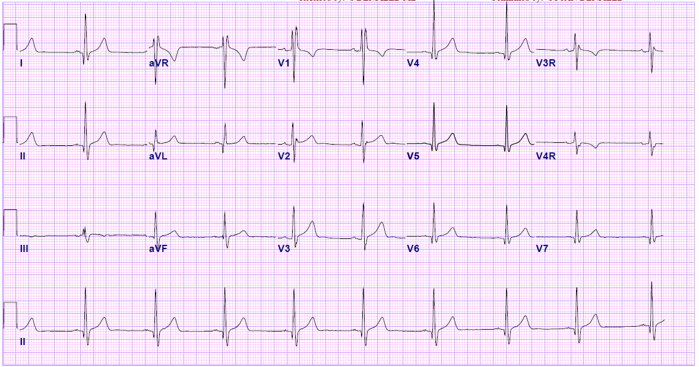
Incomplete Right Bundle Branch Block
19-y.o. female, volleyball player at PPE
ECG demonstrates incomplete right bundle branch block (IRBBB) with rSR’ pattern in V1 and QRS duration of < 120 ms.

Slide 16
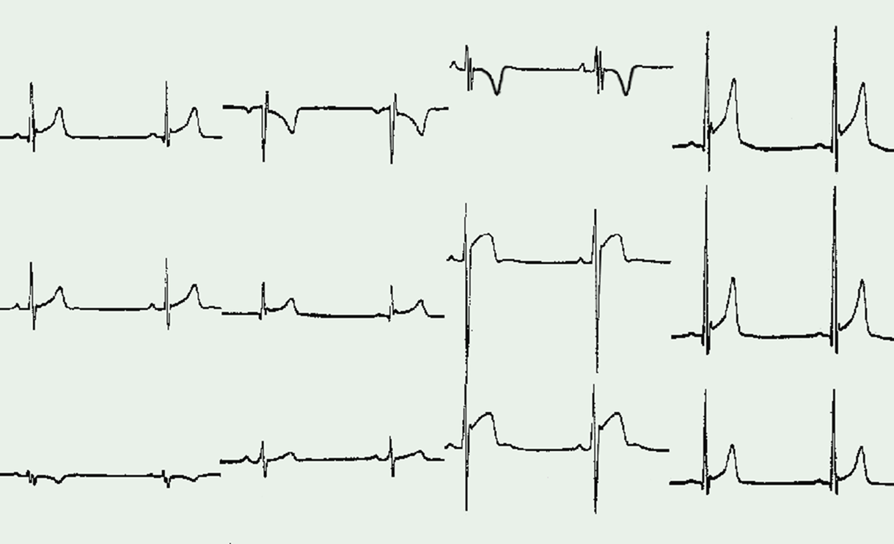
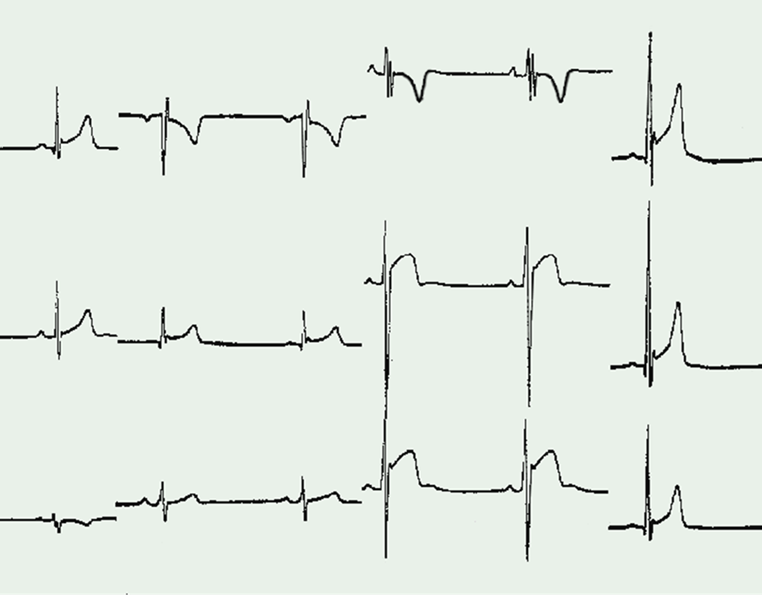
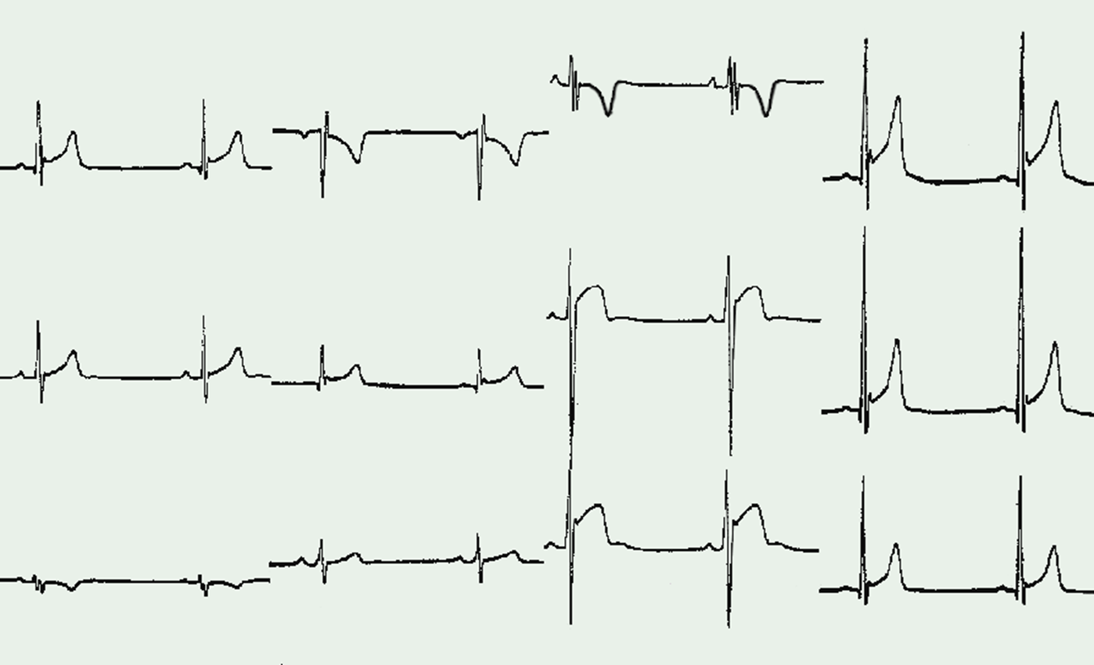


Brugada-ECG Pattern
Incomplete RBBB
Panel A
Panel B
Panel A. Brugada-ECG pattern mimicking IRBBB. The “J-wave” (arrows) of Brugada-ECG is confined to right precordial leads (V1 and V2) followed by descending ST-segment and without reciprocal “S-wave” in leads I and V6 (arrowheads).
Panel B. IRBBB in a trained athlete. The RV conduction interval is mildly prolonged (QRS duration = 115 ms) with a typical rSR’ pattern in V1 (arrow). Note also the reciprocal “S-wave” in V6 (arrow).

Slide 17
Increased R/S-wave Voltages
(Criteria for Left Ventricular Hypertrophy)

Slide 18
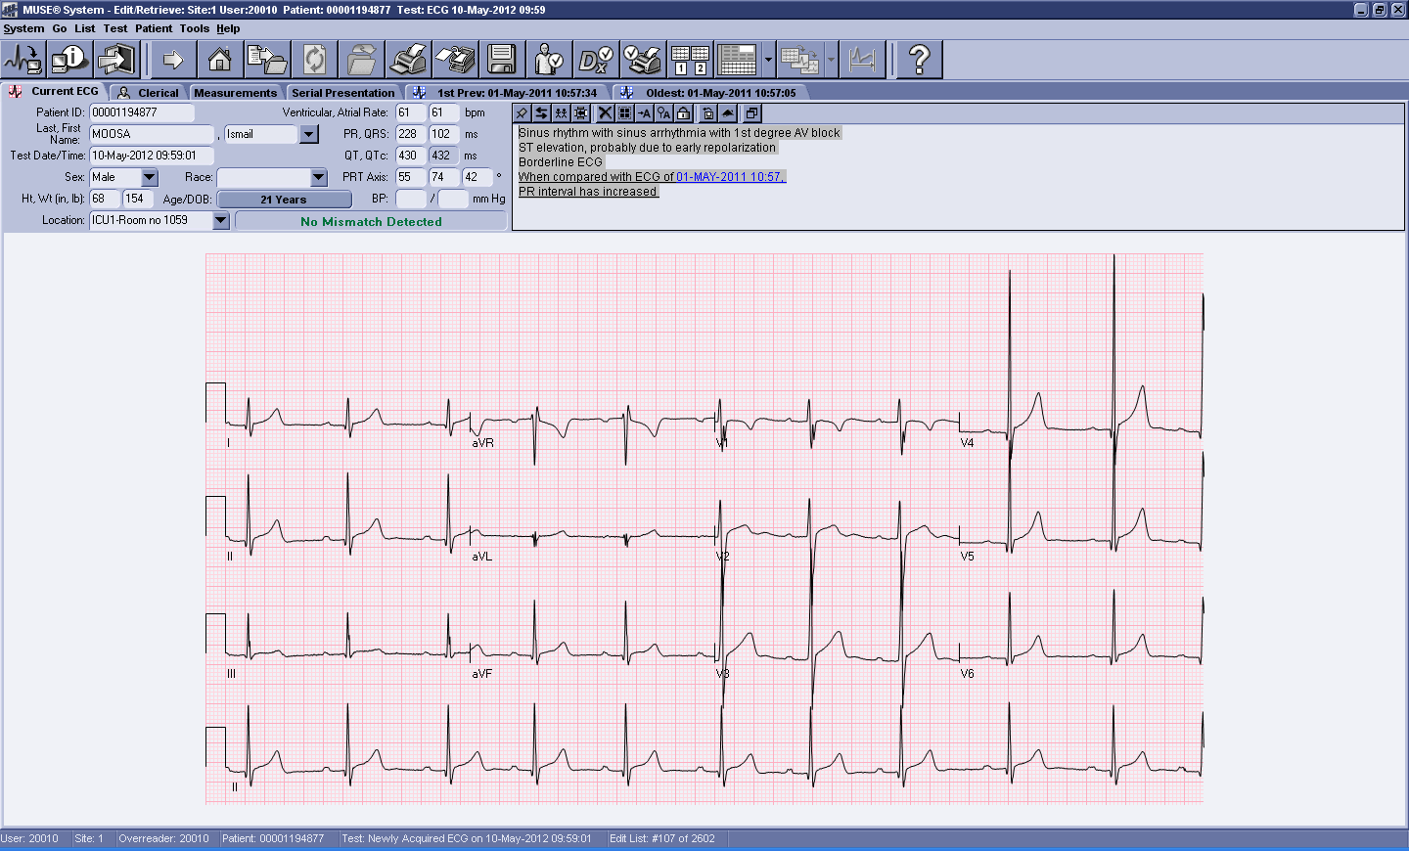
Isolated Increased QRS Voltage
LVH criteria: SV1+RV5/6 > 3.5 mV
>35mm
A 19-year old asymptomatic rower demonstrating 1st degree AV block (PR interval > 200 ms), incomplete RBBB and increased QRS voltages (S1+RV5= 4 mV)

Slide 19
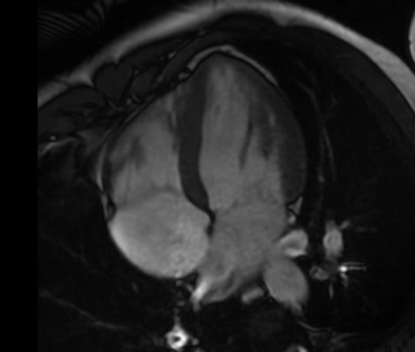
Elite, male rower
LV cavity: 64 mm; LV Volume 208 ml
Major determinants for LVH pattern are: the extent of morphologic LV remodelling, the endurance type of sport (cycling, cross-country skiing, rowing/canoeing), large body size and the male gender.

Slide 20
Increased QRS voltages (LVH) in athletes
Adult Caucasian Athletes 20-30 % ¹
Adult Afro-Caribbean Athletes 20-50 % ²
Young Caucasian Athletes 45 % ³
Adolescent African Athletes 89% ⁴
1,3) Pelliccia et al. 2000, 2011; 2,4) Sharma 1999, 2011
Notes:
20

Slide 21
Increased R/S-wave Voltages
(Criteria for Right Ventricular Hypertrophy)

Slide 22
Voltage criteria for RVH
25-y.o. male, cyclist
at PPE
RVH criteria: RV1+SV5/6 > 1.05 mV, is part of the normal spectrum of ECG findings in athletes and in the absence of other ECG or clinical markers of pathology does not require further evaluation.

Slide 23
Clinical significance of RVH
868 healthy young individuals
  627 athletes
98 patients with RV pathology
  68 ARVC
  30 with pulmonary hypertension
Males more likely than females
No correlation with ECHO RV dimensions or RVH
No correlation with pathology
Never in isolation in patients
  Extreme RAD, Atrial enlargement, Pathological TWI, ST-segment depression
Zaidi et al. Eur Heart J 2013;34:3649-3656

Slide 24
ST-Segment Elevation and
Early Repolarization

Slide 25
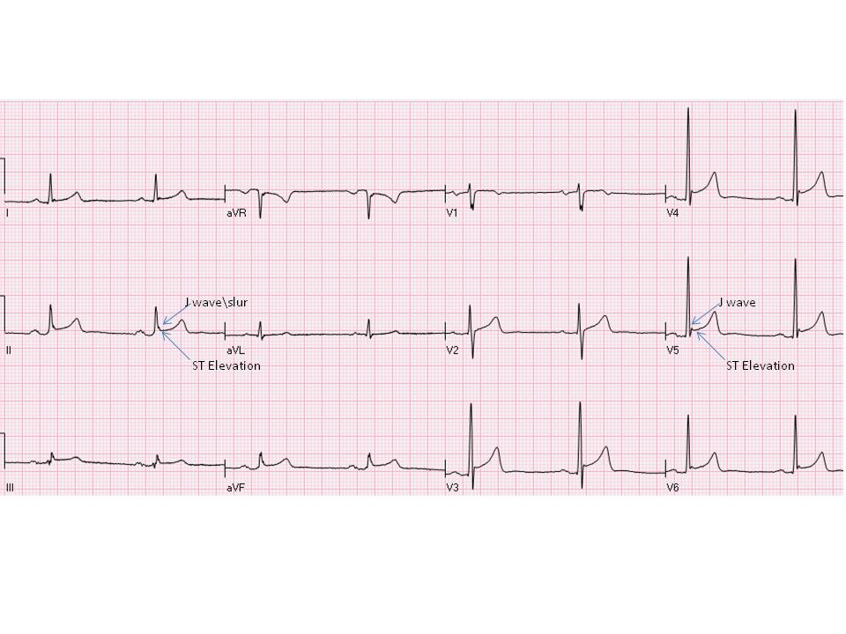
Early Repolarization
Early repolarisation is a common finding in healthy populations (2%–44%) and is more prevalent in athletes, young individuals, males and black ethnicity..

Slide 26
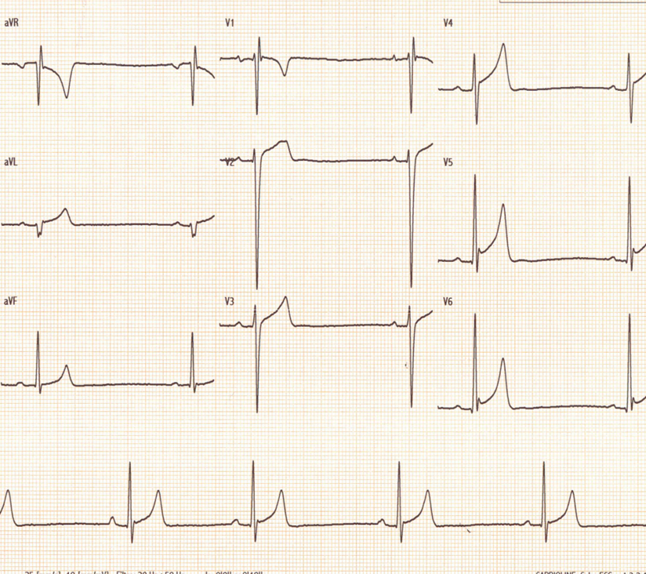
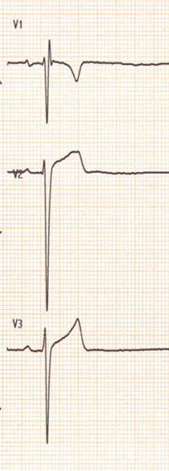
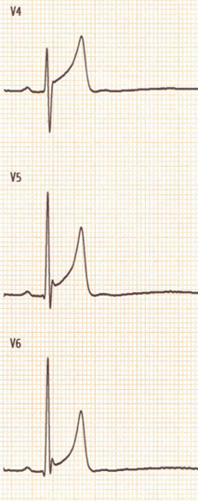

Early Repolarization
12-lead ECG from a 28-year male, elite cross-country skier,
at pre-Olympic screening

Slide 27
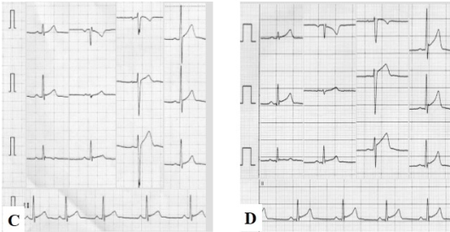
Low training (68 bpm)
Peak-training (58 bpm)
12-lead ECG in a 20-year old male rower at low-level training (Panel C) and at peak-training (Panel D)

Slide 28
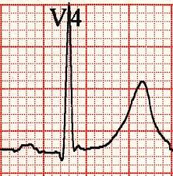
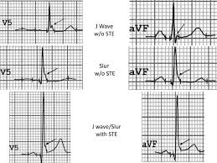
In 1961, Wasserburger et al. described the early repolarization as an elevated takeoff of the ST segment at the J junction, followed by concavity of the ST segment and tall, peaked T wave. This patterns was considered a normal variant.
In 1999 Gussak and Antzelevitch, and in 2000 Kalla and Takagi defined early repolarization an elevated notch on the downsloping limb of the QRS, followed by upsloping ST segment elevation. They suggested that early repolarization may be malignant.

Slide 29
Characteristics of benign ER
Distribution in anterior and lateral leads
Amplitude of J-wave ≤0.2 mV
ST-segment morphology ascending with positive, peaked T-wave, increased R/S-wave voltages
Dynamic changes over time associated with training/detraining
No symptoms, no family Hx of SD
(Pelliccia and Quattrini, Heart Rhythm 2014)

Slide 30
ST-segment elevation in Black/African Athletes: a domed type

Slide 31
Black athletes commonly demonstrate a repolarisation variant consisting of J-point elevation and convex ST segment elevation in the anterior leads (V1-V4) followed by terminal TWI

Slide 32
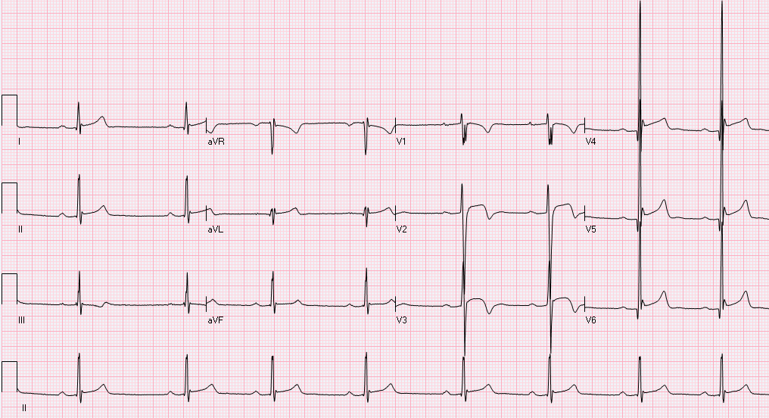
Normal Variant: Repolarization in Black/African Athletes
>35mm
A 21-year old black/African soccer player with sinus bradycardia, 1st degree AV Block, ST-segment elevation in leads II, V2-V6 (arrows), and T-wave inversion in leads V1-V3 (circles).

Slide 33
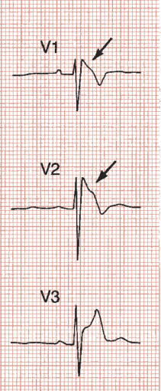
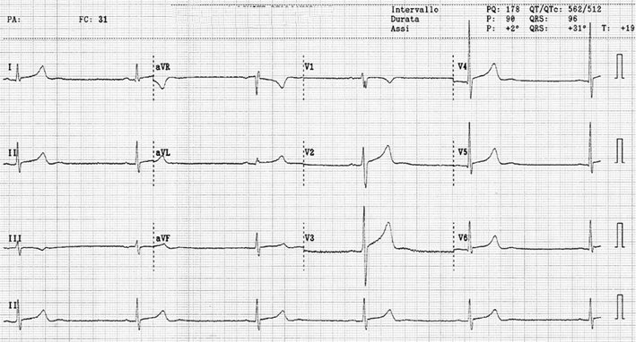
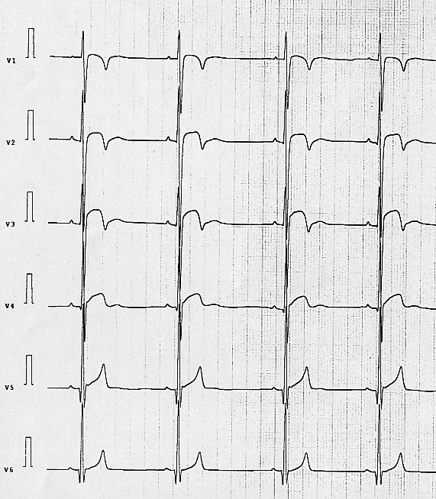
Early repolarization
in trained athletes
Brugada type 1

Slide 34
The “juvenile” pattern

Slide 35
Anterior TWI that extends beyond lead V2 (juvenile pattern) is present in 10%–15% of white, adolescent athletes aged up to 12 years.
The juvenile pattern is rare (0.1%) in white athletes aged ≥16 years or younger athletes who had completed puberty.

Slide 36
Summary :
Normal ECG Findings in Athletes

Slide 37
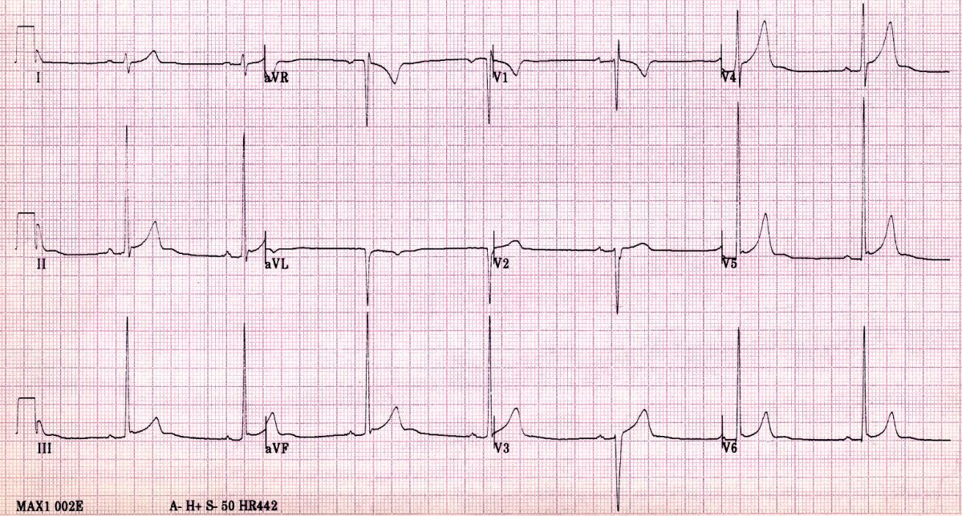
Vertical axis QRS
Incomplete RBBB
ER
SV1
RV6
Sinus bradycardia 45 bpm
SV1 + RV6 > 3.5 mV = LVH

