Slide 1

Elettrocardiografia oggi:
un lungo percorso...
dalla idoneità alla patologia
Antonio Pelliccia
Istituto di Medicina dello Sport Roma.
No relationship to disclose

Slide 2
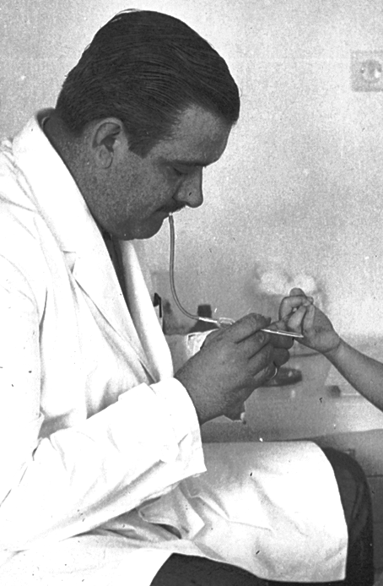
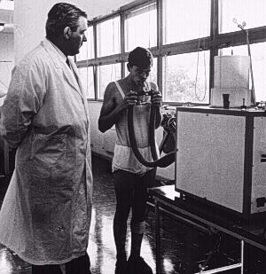
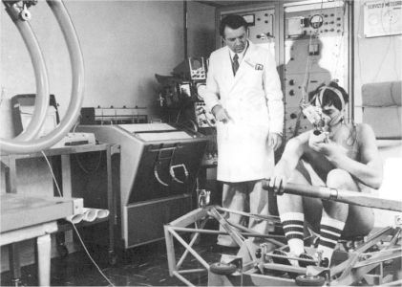
The Institute of Sport Medicine
was established in 1965
B
A

Slide 3
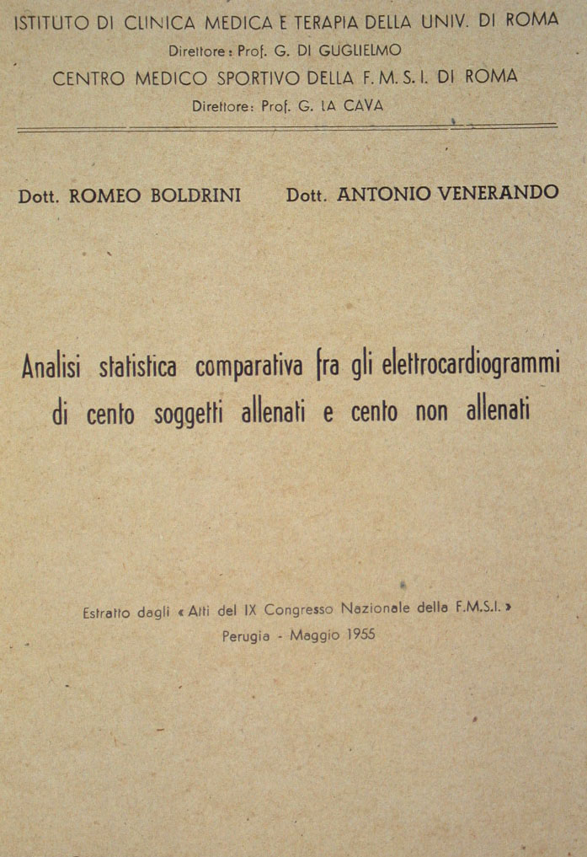
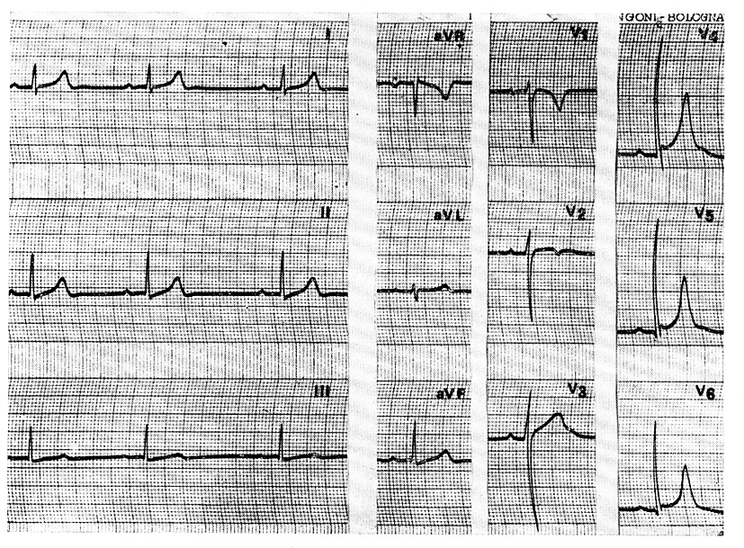
12-lead ECG special features in athletes

Slide 4
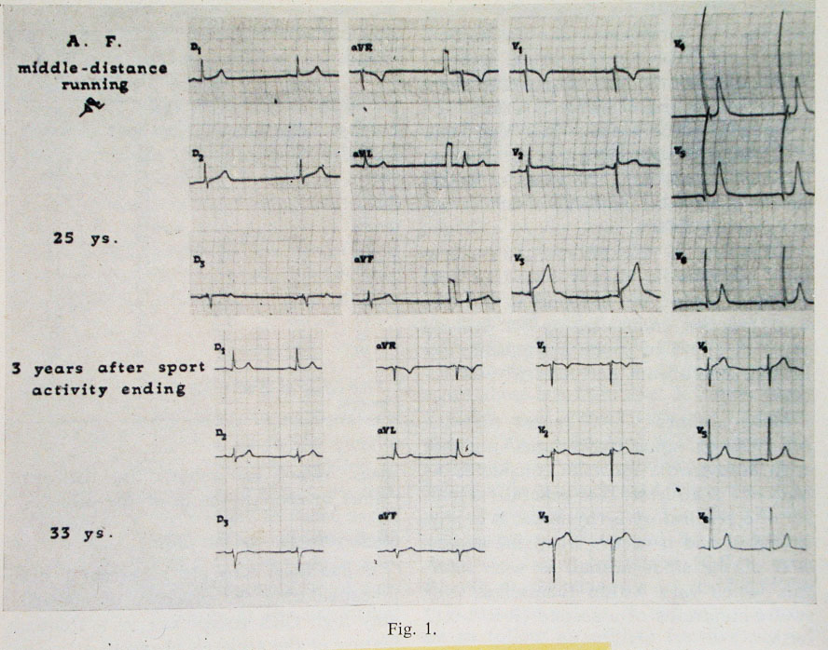
Effect of training and detraining

Slide 5
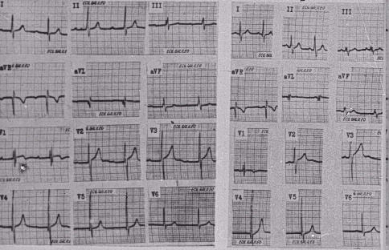

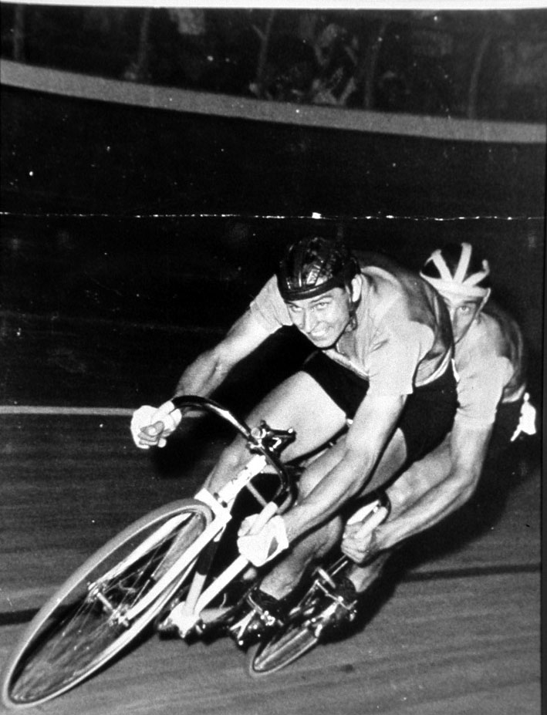
“Physiologic” A-V block in athletes
Olympic Games
Rome, 1960

Slide 6
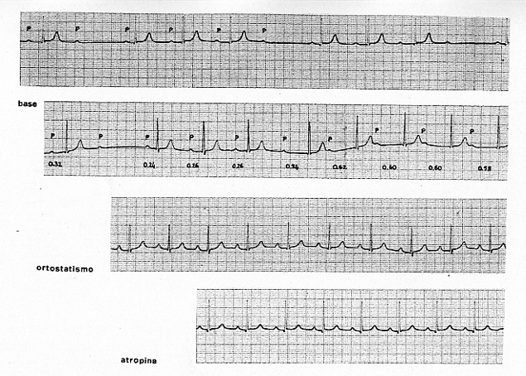
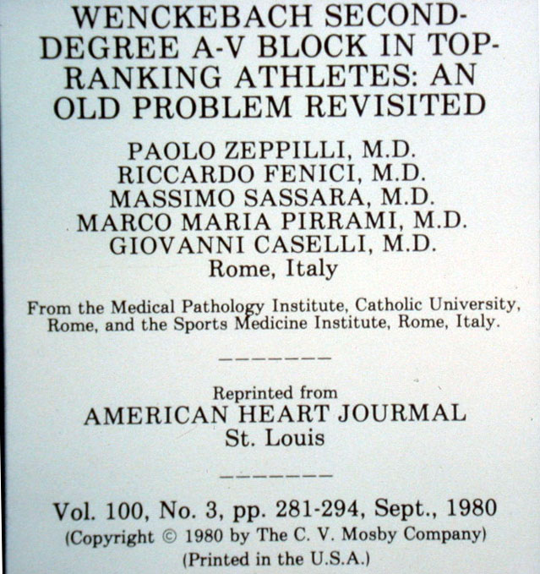
Abnormal ECG patterns in athletes

Slide 7
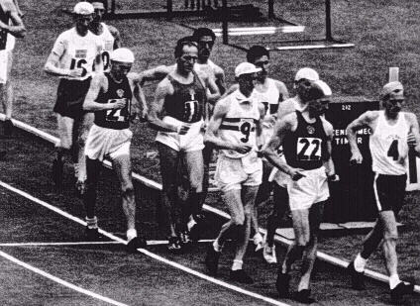
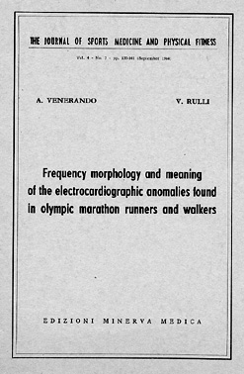
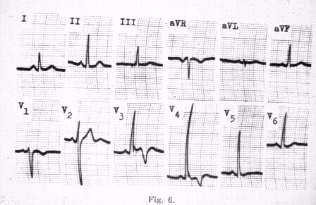
Abnormal ECG patterns in athletes

Slide 8
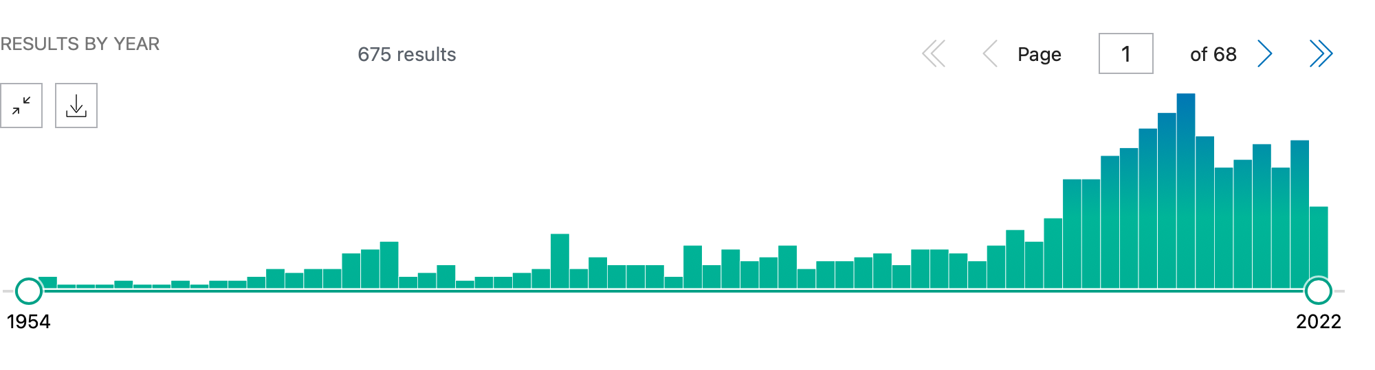
Published paper on ECG patterns in athletes, 1954 to present
2000

Slide 9
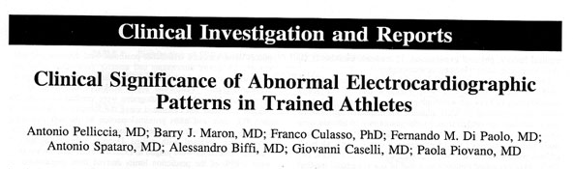
“… a variety of abnormal ECG patterns occurred in 40%; this was usually indicative of physiological cardiac remodeling.
A small but import subset of athletes showed striking ECG abnormalities that suggested CV diseases; …”
(Pelliccia et al. Circulation. 2000;102:278-84 )

Slide 10
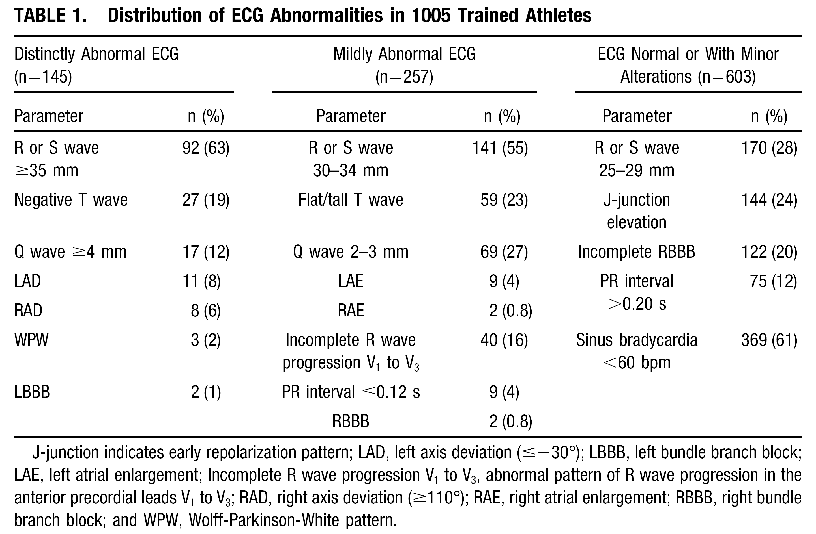
Abnormal ECG patterns in trained athletes

Slide 11
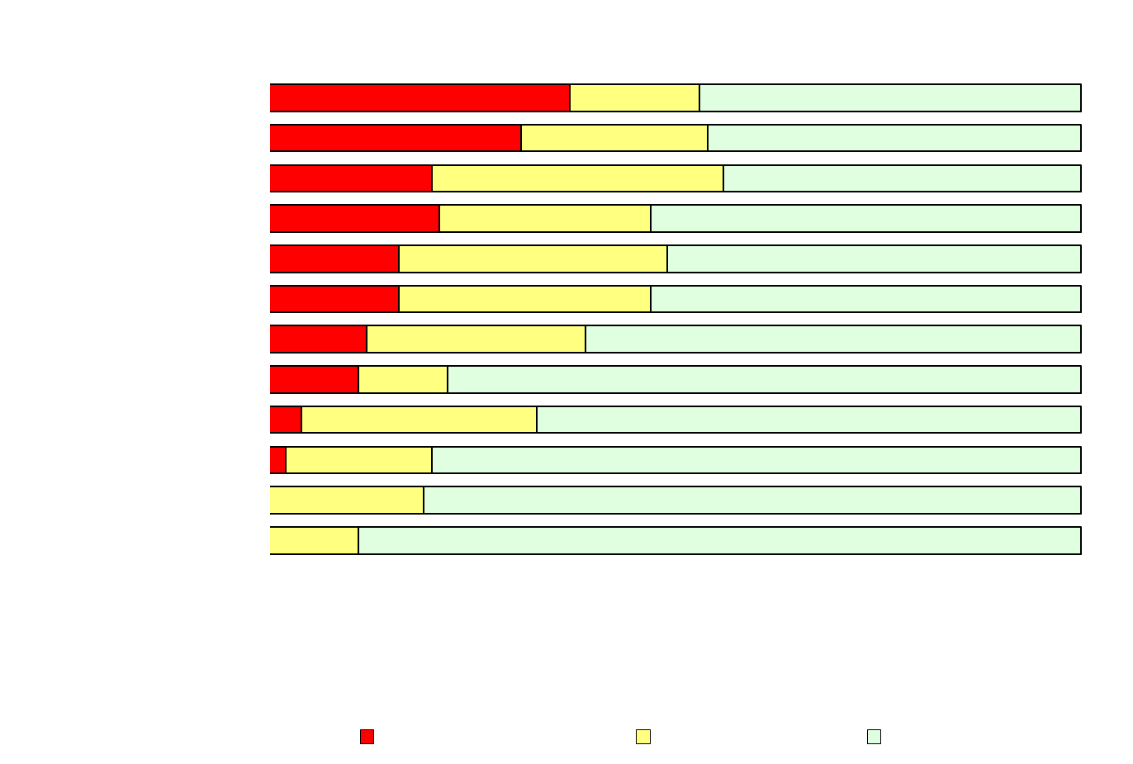
ECG patterns according to type of sport

Slide 12
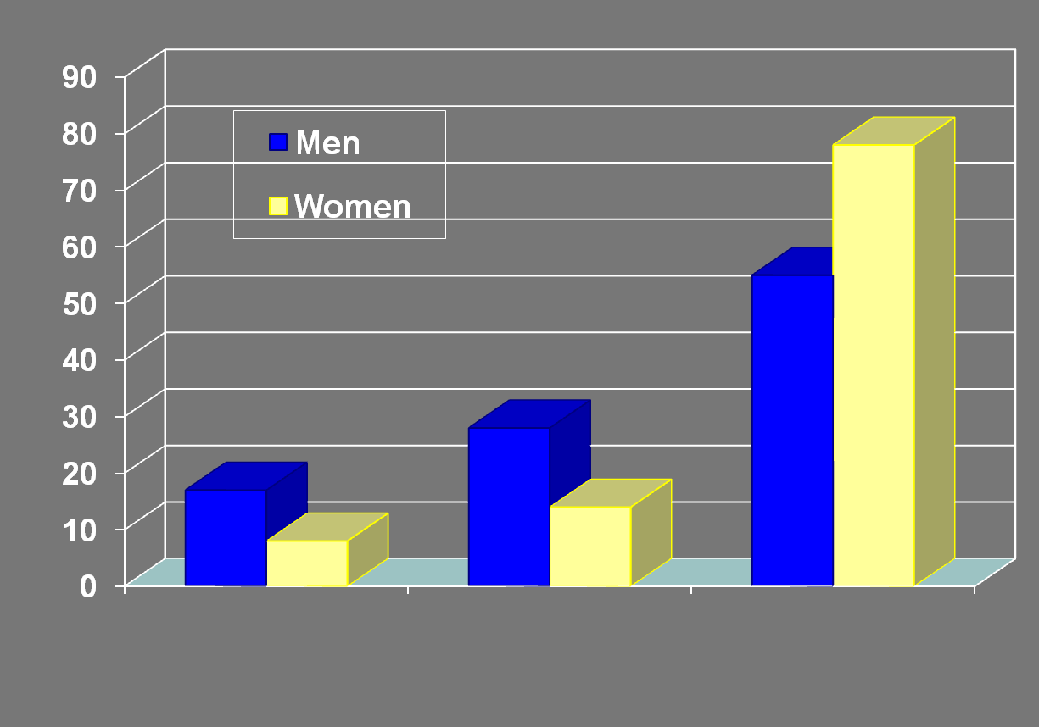
ECG patterns according to gender
P<0.001
78%
55%
P<0.001
% Athletes With Abnormal ECG
P<0.001
28%
17%
14%
8%
Distinctly
Abnormal
Mildly
Abnormal
Normal or Minor
Alterations

Slide 13
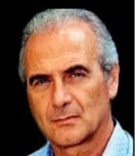
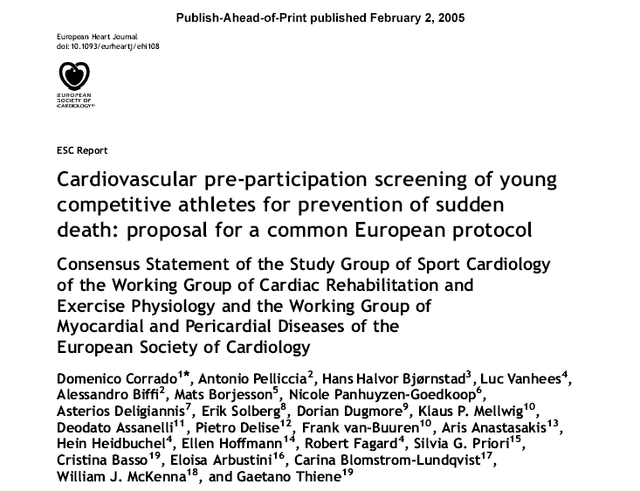
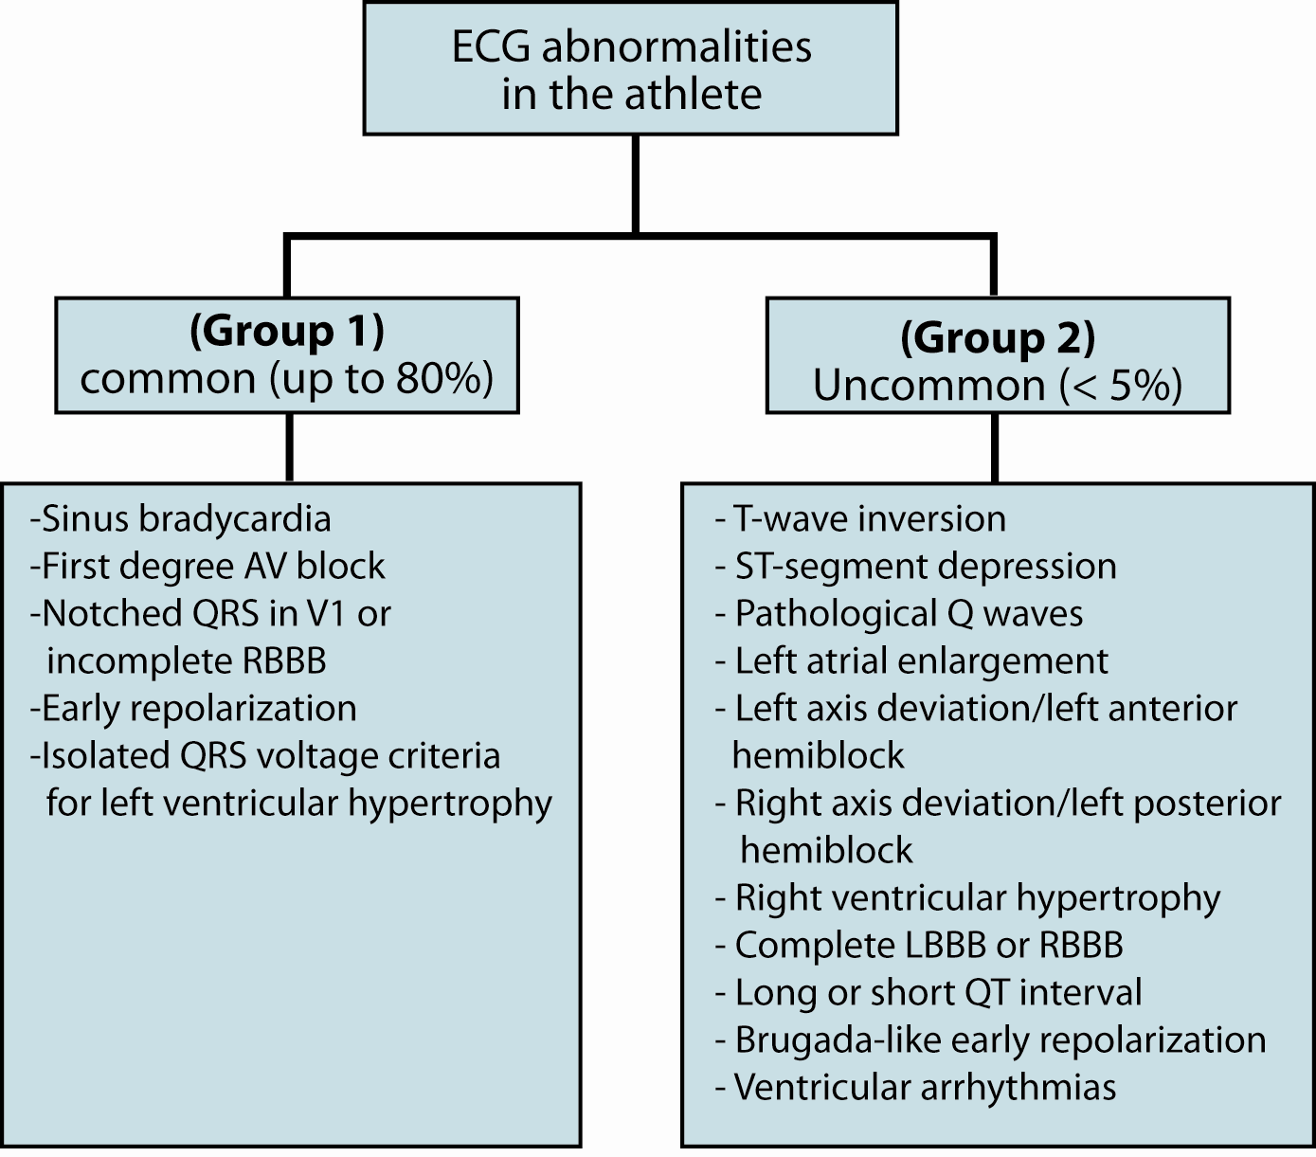
The clinical approach to read the athlete’s ECG

Slide 14
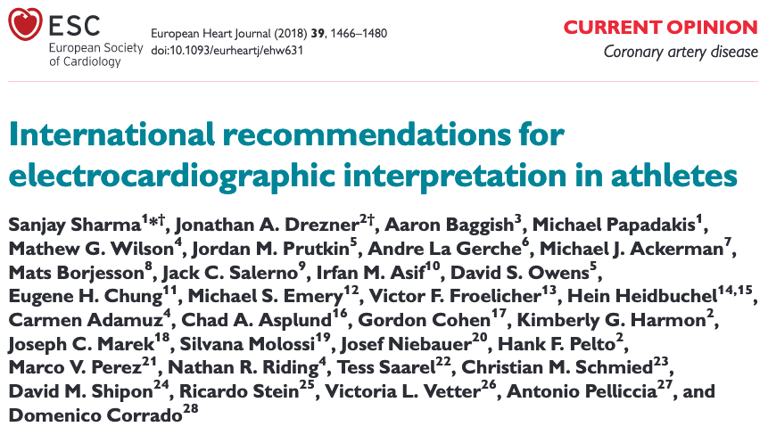
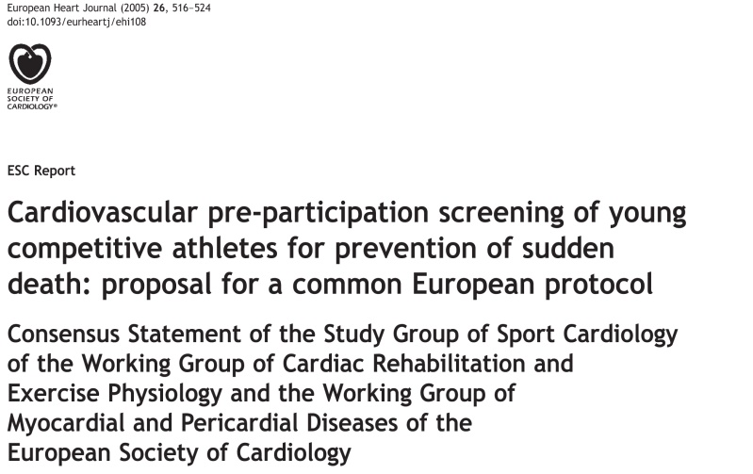



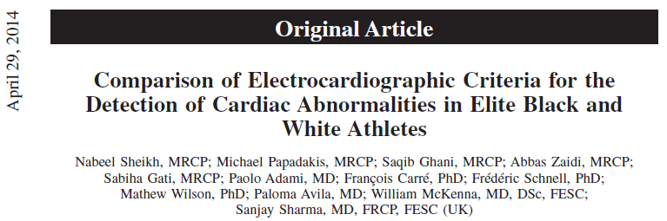

Evolving criteria to read the athlete’s ECG
2005
2010
2013
2014
2017

Slide 15
New ECG criteria criteria reduce false positives and indication to additional testing
Duthia H et al. JACC 2017

Slide 16
Current criteria to interpret the ECG in athletes

Slide 17

Abnormal ECG Findings in Athletes
T wave inversion
ST segment depression
Pathological Q waves
Complete LBBB
Premature Ventricular Beats
Ventricular pre-excitation
Long QT interval

Slide 18
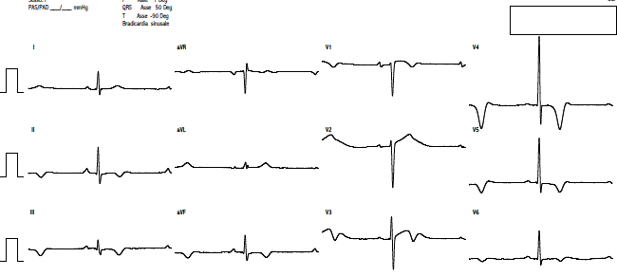
37-yrs, male runner

Slide 19
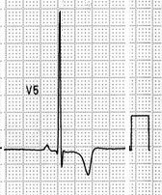
Prevalence of T-wave inversion in athletes
Elite Caucasian Athletes 2.7; 3.7% ^{1,2}
Adolescent Caucasian Athletes 2.3; 4; 9% ^{3,4,5}
Afro-Caribbean Athletes 23% ^{6,7}
Adolescent African Athletes 14% ⁸
1: Pelliccia et al. Circulation 2000
2: Sharma et al. Br J Sports Med 1999
3: Pelliccia et al. Eur Heart J 2007
4: Papadakis et al. Eur Heart J 2009
5: PE Adami Br J Sport Med 2018
6: Magalski et al. JACC 2008
7: Rawlins et al. EACPR 2010
8: DiPaolo et al. JACC 2012

Slide 20
Total Athletes
Athletes with TWI
1005
27
Infero-lateral
(V5-V6, I, aVL)
Anterior (V1-V3)
11
16
8
3
16
No structural CV disease
CV disease (HCM)
No structural CV disease
(Pelliccia et al. Circulation 2000; 102: 278)
Notes:
20

Slide 21
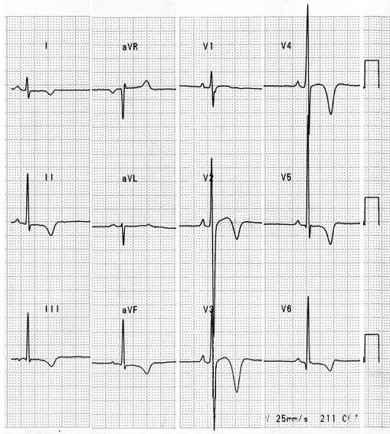
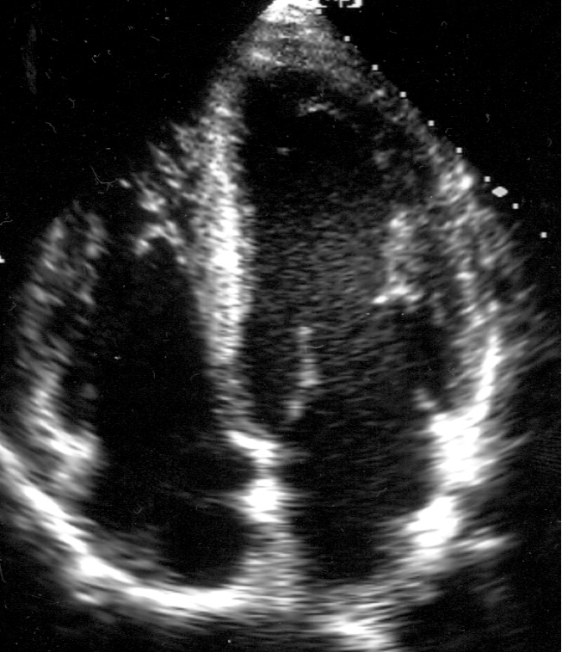
MM, soccer player at age of 28 years
PFW
IVS
LV
RV
RA
LA
Notes:
21

Slide 22
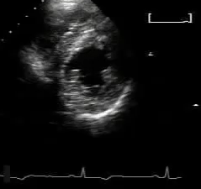
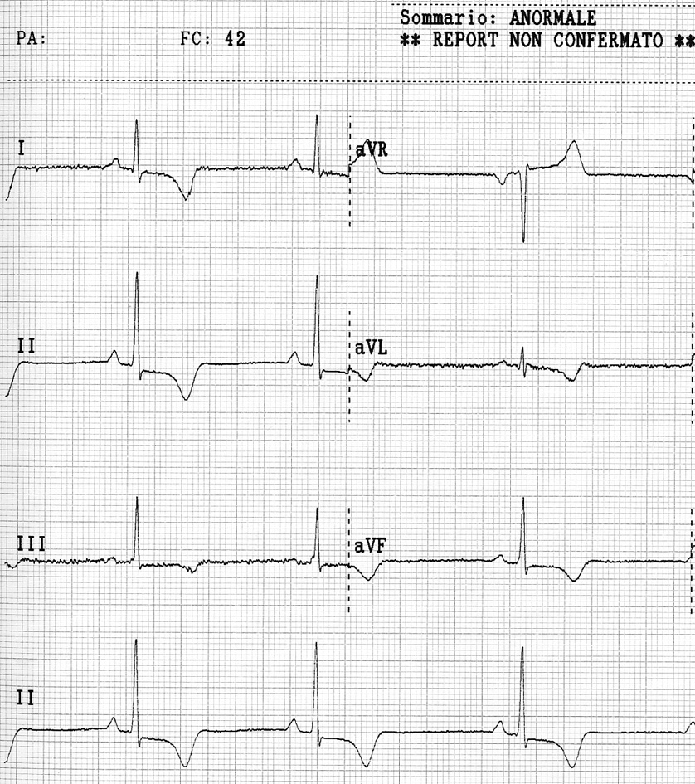
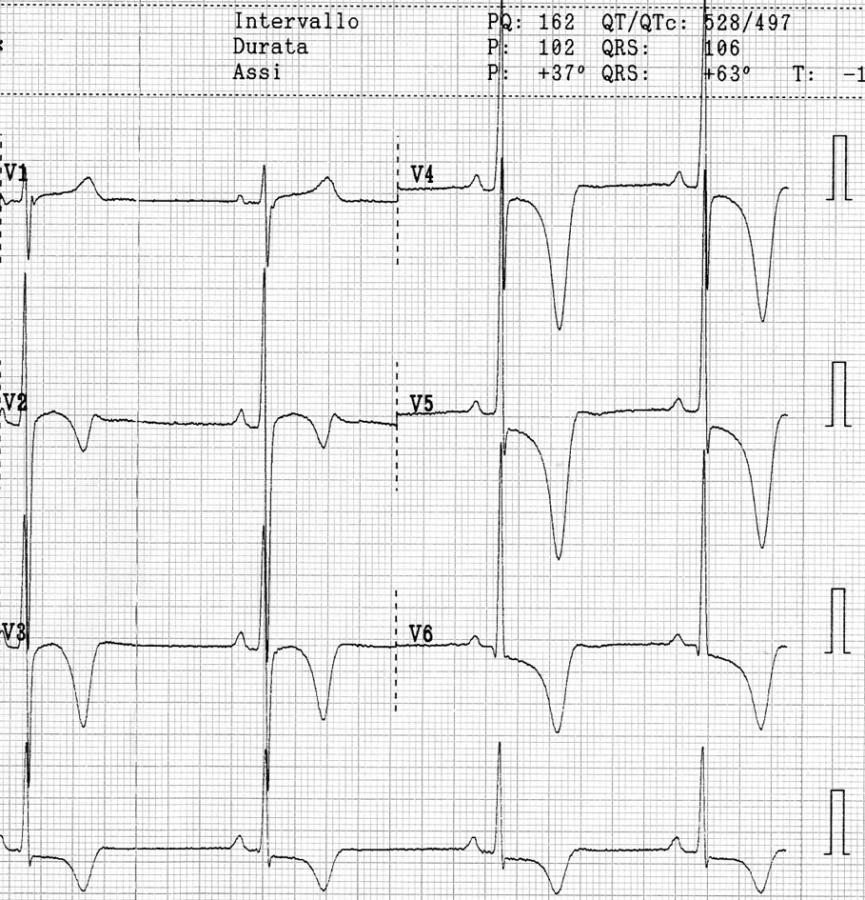
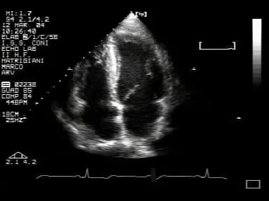
Same athlete, at the age of 33 years
Notes:
22

Slide 23

Repolarization abnormalities precede morphologic changes in CMPs

Slide 24
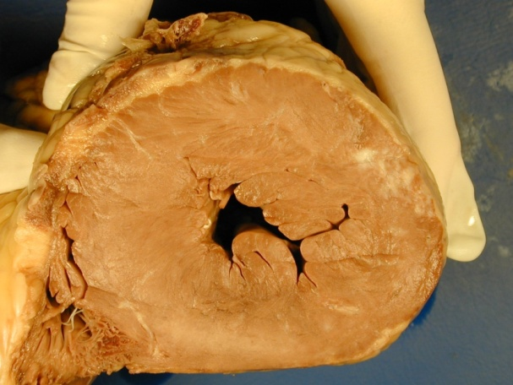
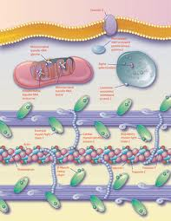
ECG abnormalities precede LVH in HCM
LV Hypertrophy
Abnormal ECG
Genotype anomalies
Adulthood
Adolescence
Clinical diagnosis
of HCM
Notes:
24

Slide 25
Long-term follow-up of athletes with abnormal ECG (Pelliccia et al. New Engl J Med 2008; 358: 152-63)
Study group
81
9-year follow-up
No symptoms,
no CV disease
70
5
1, sudden death
1, cardiac arrest
6
Other CV disease (hpt 3, CAD 1, myoc 1, SVT 1)
Cardiomyopathies (HCM3; ARVC1; DCM1)
Notes:
25

Slide 26
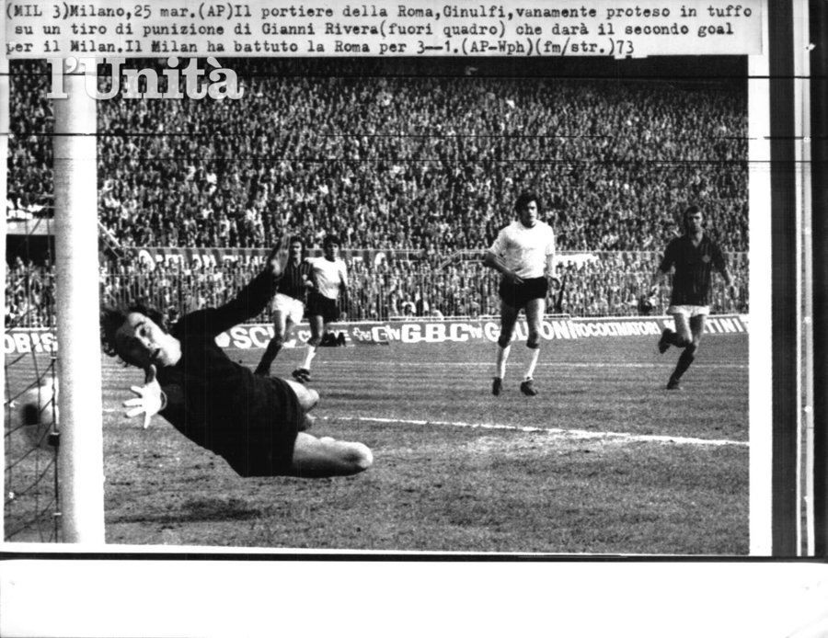
The oldest case …
The
Alberto, goalkeeper, 1970s

Slide 27
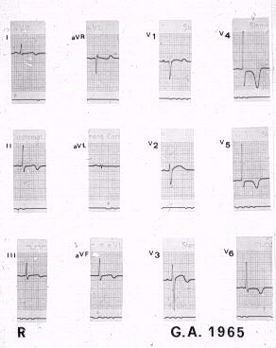
Alberto
27 year-old,
Rome 1975
Notes:
27

Slide 28
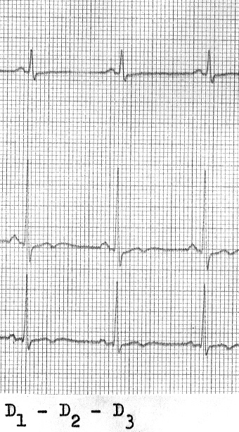
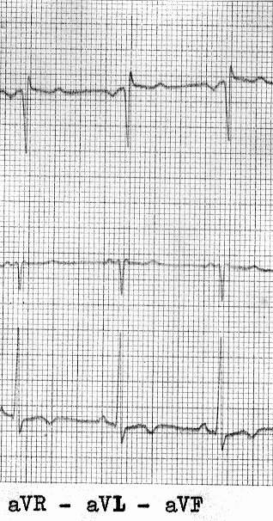
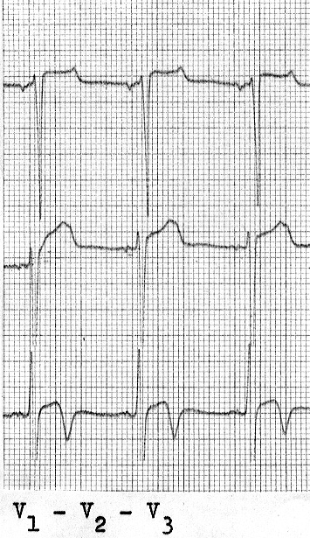
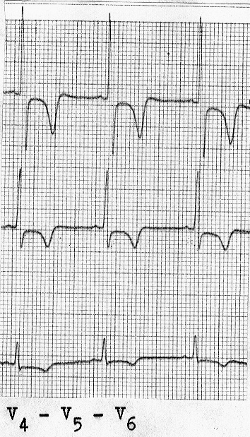
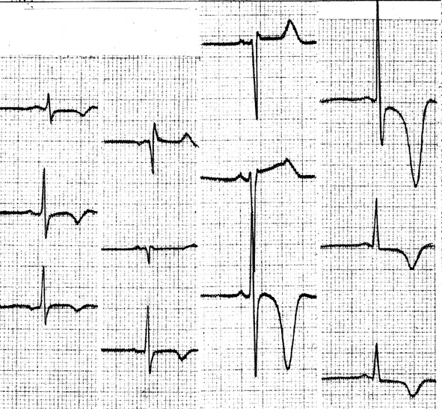
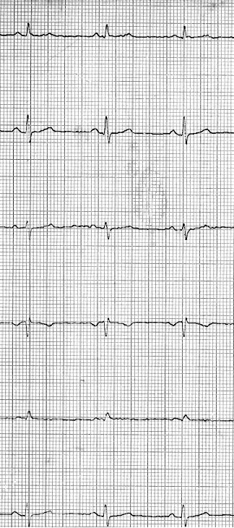
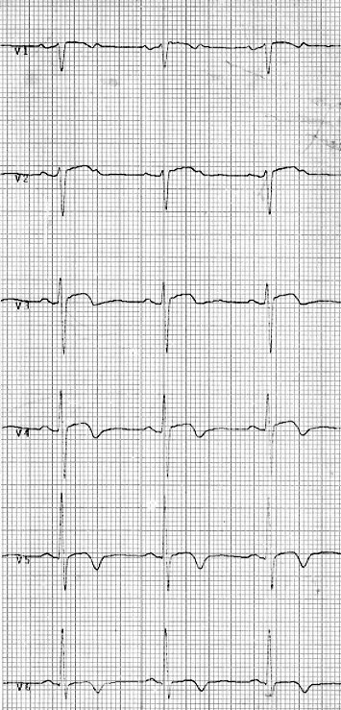
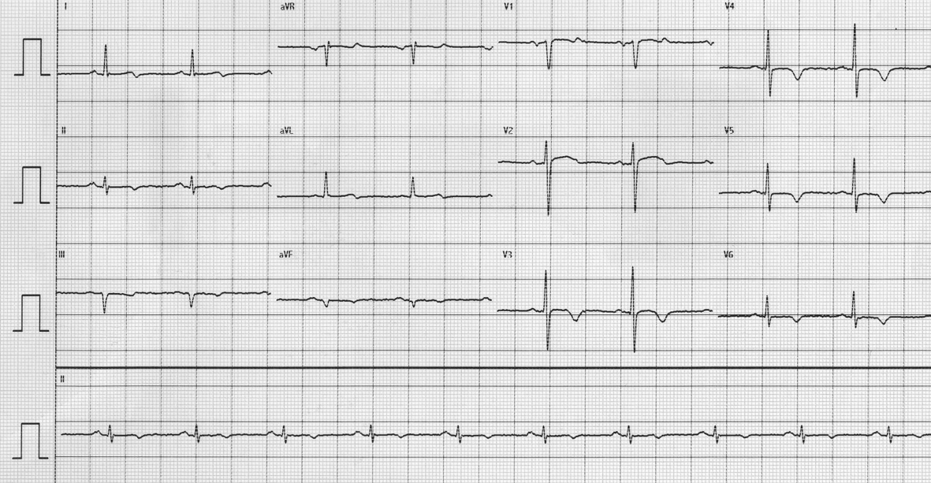
I
AVR
V₁
V₄
I
AVR
V₁
V₄
II
V₂
II
AVL
V₂
V₅
AVL
V₅
III
III
AVF
V₃
V₆
AVF
V₃
V₆
29yrs
37yrs
I
AVR
V₁
V₄
II
V₂
AVL
V₅
III
AVF
V₃
V₆
56yrs
69yrs

Slide 29
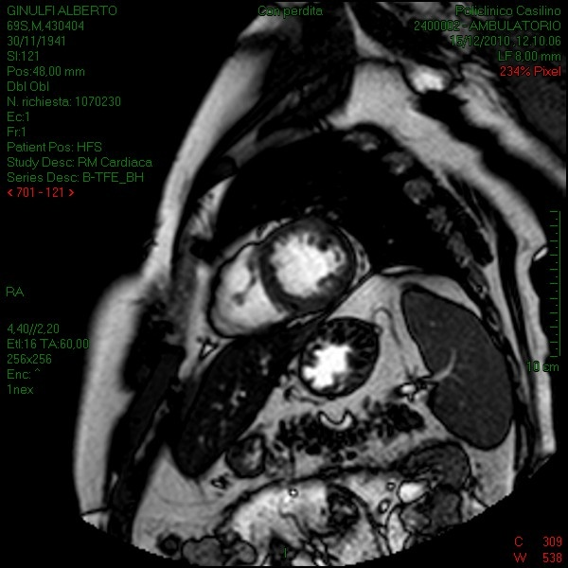
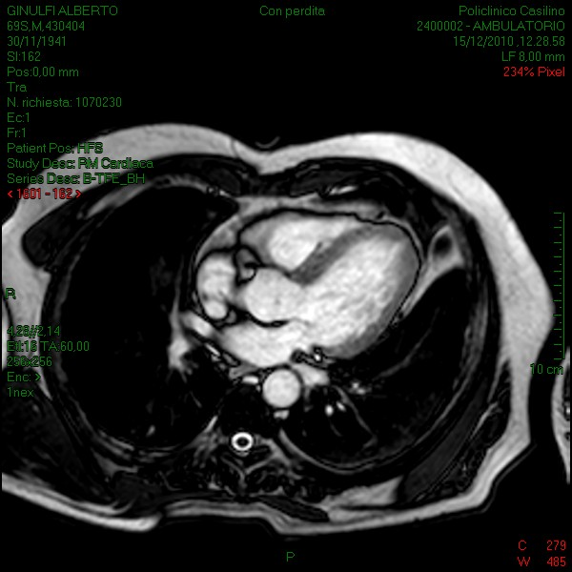
CMR, Rome 2012
A
B
Alberto, at age of 69 yrs

Slide 30
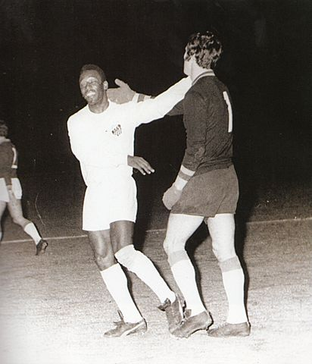
Conclusion :
Abnormal ECG (repolarization) pattern may be present for life without associated cardiac morphologic abnormalities
Likely these individuals are G+ P-
Presence of isolated ECG abnormalities without LVH do not justify diagnosis of HCM and are usually (>80%) associated with normal life expectancy

Slide 31


154
137
(89%)
F M Di Paolo
Increased R/S wave voltage (LVH)
154 young native African adolescent soccer players, participating to 2009 African Championship.
14 (9%)
10 (7%)
21 (14%)
LAE
Q waves
Inverted T waves
( from Di Paolo F, Schmied C et al., JACC 2012)

Slide 32
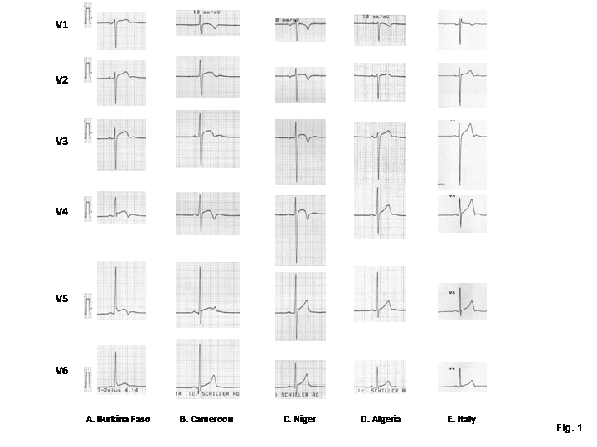
Representative ECGs of adolescent soccer players, from
Burkina Faso, Cameroon, Nigeria, Algeria vs. Italy.

Slide 33
Anterior TWI: 1%
Infero-lateral TWI: 0.5%
LVWT: 9 mm
LV cavity: 54 mm
LV mass index: 82 g/m2
Anterior TWI: 2%
Infero-lateral TWI: 1.5%
Anterior TWI: 8%
Infero-lateral TWI: 5%
LVWT: 8.7 mm
LV cavity: 52 mm
LV mass index: 77 g/m2
LVWT: 9.6 mm
LV cavity: 54 mm
LV mass index: 88 g/m2

Slide 34
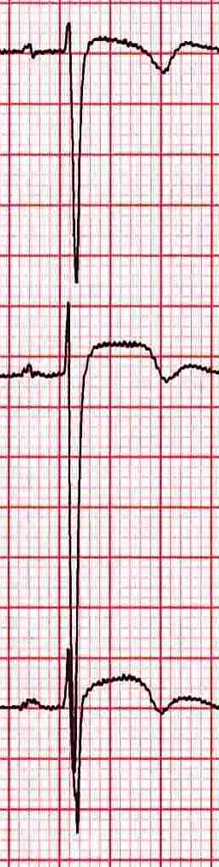
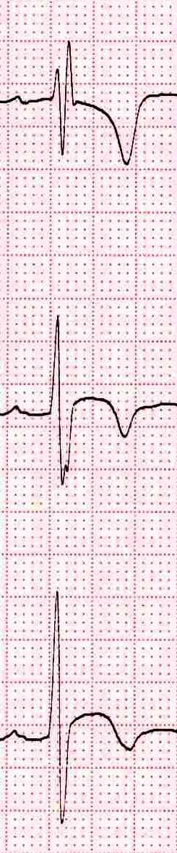

T-wave inversion in anterior precordial leads (V1-V3,4)
suggesting that inverted T-wave in anterior precordial leads may represent a race-related ECG pattern …
Black athletes (rarely, Caucasian) show a disproportinate prevalence (≈10%) of inverted T-wave in anterior precordial leads V1-V3(V4)
… in the absence of structural cardiac abnormalities, and incidence of cardiac events in a short-term period,
Notes:
Elevated J points
Elevated by > -0.2mV as described by Hassieuguerre in survivors of SCD from idiopathic VF
Brugada syndrome
Anterior myocardial infarction
Cardiomyopathy (ARVC)

Slide 35



… a single screen in adolescence does not exclude the later development of genetic or acquired cardiac disease, and warrants serial evaluations…

Slide 36
Serial evaluations increase sensitivity of the screening (Sarto et al. Circulation 2021)
The 65% of CV diagnoses were made on repeated screening evaluations.
More frequently identified were inherited cardiomyopathies (64%) and acquired nonischemic LV scar with ventricular arrhythmias (83%).

Slide 37



28 year-old, female athlete without apparent structural RV abnormalities
Notes:
37

Slide 38


The vast majority of anterior TWI observed among healthy athletes (both Caucasian and Afro-Caribbean) was preceded by J-point elevation. This marker was never observed among patients with ARVC.
J-point elevation <1 mm and TWI extending beyond V4 showed a sensitivity for RV cardiomyopathy of 100%.
Anterior TWI in Athlete
Anterior TWI in ARVC

Slide 39
Abnormal ECG Findings in Athletes
T wave inversion
ST segment depression
Pathological Q waves
Complete LBBB
Premature Ventricular Beats
Ventricular pre-excitation
Long QT interval

Slide 40


PVBs in athletes: the most common ECG abnormality

Slide 41
Long-term consequences of PVBs in athletes
355
71
153
131
Frequent/complex VAs (>2000 PVBs, >1 NSVT)
Less frequent VAs (<2000 PVBs, no NSVT)
No, or rare VAs (<100 PVBs)
8-year prospective follow-up
1, sudden death
8, started drugs
No symptoms, no CV events
No symptoms, no CV events

Slide 42



Evolving criteria on significance of PVBs
LBBB/RBBB and inferior axis
RBBB narrow QRS, inferior/horizontal axis; fascicular
RBBB large QRS and superior axis
LBBB and superior axis
by D’Ascenzi and Zorzi, 2016
Notes:
Fare riferimento al lavoro iniziale di D’Ascenzi

Slide 43



Exercise-PVBs are commonly associated with LGE on CMR
Exercise-PVBs
Resting-PVBs
(Cipriani, Bauce et al. Heart Rhythm 2018)
Notes:
I BEV indotti dall’esercizio sonon usualmente associati ad un substrato patologico

Slide 44

Clinical outcome in elite athletes with uncommon PVBs
($≥$50 PVBs, polymorphic, couplets, or NSVT)
205
LV or RV outflow tract,
or Fascicular
87
Common
PVBs
118
Uncommon PVBs
LV or RV free wall, or polymorphic, couplets, NSVT
1 CV disease
10 CV disease
6-year (1-14) follow-up
No CV disease
4 CV disease
Notes:
atleti IMSS 2005-2010: 4,962 di cui:
no indication ECG monitoring: 3,949
24h ECG monitoring: 1,013
Dei 1013:
popolazione generale di età compresa tra 15 e 50 anni senza PVCs (<50 PVCs): 441
esclusi (<15 e >50 anni/paralimpici): 367
popolazione studio: 205

Slide 45
Abnormal ECG Findings in Athletes
T wave inversion
ST segment depression
Pathological Q waves
Complete LBBB
Premature Ventricular Beats
Malignant Early Repolarization
Long QT interval

Slide 46


Early repolarization and J-wave
In 1961, Wasserburger et al. described the early repolarization as an elevated takeoff of the ST segment at the J junction, followed by concavity of the ST segment and tall, peaked T wave. This patterns was considered a normal variant.
In 1999 Gussak and Antzelevitch, and in 2000 Kalla and Takagi defined early repolarization an elevated notch on the downsloping limb of the QRS, followed by upsloping ST segment elevation. They suggested that early repolarization may be malignant.

Slide 47


Michel Haussaiguerre
NEJM 2008; 358: 2016-23

Slide 48




Early Repolarization
12-lead ECG from a 28-year male, elite cross-country skier, at pre-Olympic evaluation

Slide 49

Distribution of ER in athletes
73 (72%)
Anterior
+
Lateral
+
Inferior
26 (25%)
Lateral
3 (3%)
Inferior

Slide 50
12-lead ECG characterization
 | Athletes J-wave/QRS slurring (n = 102) | Athletes without J-wave/QRS slurring (n = 602) | p value
Age (yrs) | 25.0±4.9 | 25.2±5.4 | ns
Male gender (%) | 83 (74%) | 380 (59%) | <0.01
BSA (m2) | 1.90±0.20 | 1.92±0.24 | ns
BP (mmHg) | 116±9/75±7 | 117±10/75±7 | ns
Heart rate (bpm) | 54±10 | 58±11 | <0.01
QRS duration (s) | 0.093±0.010 | 0.093±0.012 | ns
Sokolow criteria for LVH | 78 (76%) | 184 (31%) | <0.001
ST-segment elevation (n; %) | 86 (84%) | 400 (66%) | <0.001
Q-waves (n; %) | 30 (27%) | 91 (14%) | <0.001
Inverted T-waves (n; %) | 6 (5%) | 19 (3%) | ns
IRBB (n; %) | 28 (25%) | 236 (37%) | <0.05
PR interval (s) | 0.16±0.03 | 0.16±0.03 | ns
QTc interval (s) | 0.40±0.03 | 0.40±0.02 | ns

Slide 51
ECG/Echo features of athletes with ER

Slide 52

Low training (68 bpm)
Peak-training (58 bpm)
20-year old male rower at low-level training (Panel C) and at peak-training (Panel D)

Slide 53
Clinical Outcome
J-wave/QRS slurring
102
602
NO J-wave/QRS slurring
1 - 18 years (mean, 6) follow-up
No CV events, symptoms, or evidence of CV disease
Death (car accident) = 1
Atherosclerotic CAD = 1
Systemic hypertension = 1
RF ablation for AVRNT = 2

Slide 54
Characteristics of benign ER
Distribution in anterior and lateral leads
Low amplitude of J-wave (≤0.2 mV)
ST-segment morphology (ascending with positive, peaked T-wave), increased R/S-wave voltages
Modest dynamic changes over time
No symptoms, no family Hx of SD
(Pelliccia and Quattrini, Heart Rhythm 2014)

Slide 55
Abnormal ECG Findings in Athletes
T wave inversion
ST segment depression
Pathological Q waves
Complete LBBB
Premature Ventricular Beats
Ventricular pre-excitation
Long QT interval
A new marker of risk ?

Slide 56
Low QRS voltages: a “new” ECG marker for risk ?
Obesity
Enphysema
Pericar. effusion
Amyloidosis
AC
Low QRS voltage defined as amplitude from nadir to zenith <0.5 mv in standard leads (with total sum L1 to aVF < 3.0 mv)

Slide 57
Exercise testing
516
493
(96%)
23
(4%)
Normal QRS voltages
Low QRS voltages

Slide 58



Exercise ECG
Resting ECG

Slide 59


Slide 60







A glimpse to the next future of ECG implementation

Slide 61




Advantages
Limitations
Textile ECG
Feasible during exercise
Only one-lead ECG;
Artifacts during exercise
Feasible during exercise;
Large implementation among athletes
Large discrepancies with lead-recorded ECG
Wearable HR monitoring
Feasible during exercise; Suitable for long-term recording
Good sensitivity to detect arrhythmias (AFib; VT)
Patch ECG monitoring
Feasible during exercise;
Large implementation among athletes
Good sensitivity to detect arrhythmias (AFib; VT), less AVBlocks
Smartphone ECG

Slide 62


















Thank you for your attention
See also: www.antoniopelliccia.it

