Slide 1
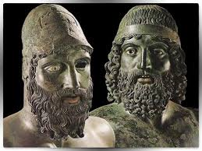
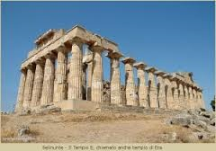
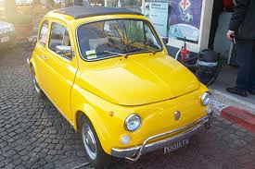
Prevenzione nella popolazione generale e negli sportivi
Antonio Pelliccia, MD, FESC
Instituto di Medicina e Scienza dello Sport. CONI
www.antoniopelliccia.it

Slide 2
Post-myocarditis

Slide 3
ECG in arrhythmogenic cardiomyopathy
PVBs
Inverted T-wave
LQRSV

Slide 4
1. Presence of PVBs at baseline/effort ECG
The aim of the clinical assessment in an athlete with VAs is to assess presence of a pathologic arrhythmogenic substrate

Slide 5
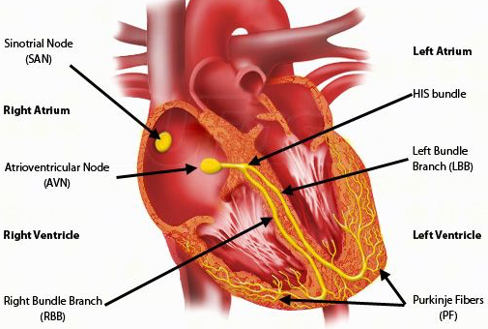
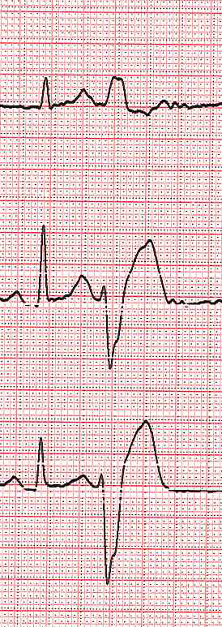
Simplified classification of the PVBs by morphology
RVOT 60%
Fascicular 20%
LBBB superior axis 15%
RBBB superior axis 5-10%
LBBB/RBBB and inferior axis
RBBB narrow QRS and inferior/horizontal axis; fascicular
RBBB large QRS and superior axis
LBBB and superior axis
by D’Ascenzi and Zorzi, 2016
Notes:
Fare riferimento al lavoro iniziale di D’Ascenzi

Slide 6
Investigation of PVBs pattern in elite athletes
4,595
Athletes examined
3,949
24-h ECG monitoring
646
441
No, or <50 PVBs
205
either >50 PVBs, polymorphic, couplets, or NSVT
(Pelliccia A et al. Clinical correlates and outcome of the patterns of premature ventricular beats in Olympic athletes: a long-term follow-up study. Eur J Prev Cardiol. 2020)
Notes:
Questa è la nostra esperienza …

Slide 8
($≥$50 PVBs, polymorphic, couplets, or NSVT)
PVBs patterns and clinical outcome in elite athletes
205
LV or RV outflow tract,
or Fascicular
87
Common
PVBs
118
Uncommon PVBs
LV or RV free wall, or polymorphic, couplets, NSVT
1 CV disease
10 CV disease
6-year (1-14) follow-up
No CV disease
4 CV disease
Notes:
atleti IMSS 2005-2010: 4,962 di cui:
no indication ECG monitoring: 3,949
24h ECG monitoring: 1,013
Dei 1013:
popolazione generale di età compresa tra 15 e 50 anni senza PVCs (<50 PVCs): 441
esclusi (<15 e >50 anni/paralimpici): 367
popolazione studio: 205

Slide 9
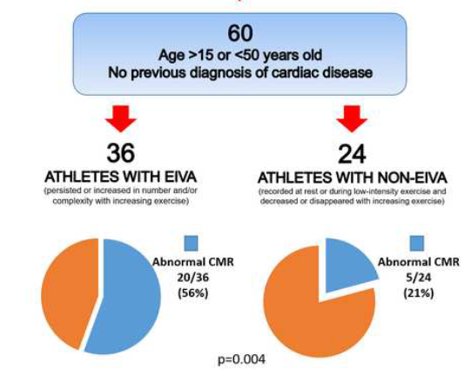
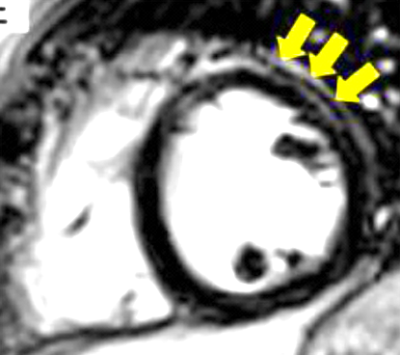
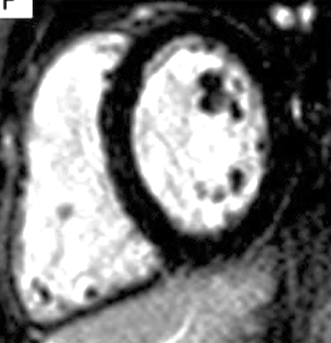
Exercise-PVBs are commonly associated with LGE on CMR
Exercise-PVBs
Resting-PVBs
(Cipriani, Bauce et al. Heart Rhythm 2018)
Notes:
I BEV indotti dall’esercizio sonon usualmente associati ad un substrato patologico

Slide 10
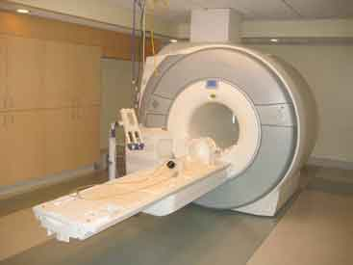
Investigation for cardiac substrates of PVBs in athletes
Athletes with VAs undergoing CMR
(2019-21)
(78%, uncommon PVBs)
195
62
(32%)
133
Positive CMR
Negative CMR
39, NILVS
16, CMPs
7, MVP
(Maestrini V. et al. Unpublished data)
Notes:
Questa è la nostra esperienza …

Slide 11
39, LGE
at CMR
Patterns of VAs
123,
No LGE
Polymorphic
<0.001
59%
205
37%
Couplets
<0.002
64%
31%
LBBB, superior axis
0.51
10%
14%
RBBB, superior axis
0.76
14%
16%
LBBB inferior axis
<0.002
7%
23%
Notes:
atleti IMSS 2005-2010: 4,962 di cui:
no indication ECG monitoring: 3,949
24h ECG monitoring: 1,013
Dei 1013:
popolazione generale di età compresa tra 15 e 50 anni senza PVCs (<50 PVCs): 441
esclusi (<15 e >50 anni/paralimpici): 367
popolazione studio: 205

Slide 12
2. Presence of inverted T-wave in anterior ECG leads
V₁
Inverted T-wave in anterior precordial leads (V1 to V3)
Need to exclude primarily A(RV)C
V₂
V₃
V₄

Slide 13
Athletes with TWI and CMR (2019-2021)
110
Infero-lateral
93
Anterior (beyond V2)
17
46
47
14
3
No structural CV disease
CV disease (HCM)
No structural CV disease
Notes:
13

Slide 14
42 year-old, female runner with evidence of structural arrhythmogenic substrate at CMR

Slide 15
Same athlete on effort ECG

Slide 16
The same athlete,
an year before …

Slide 17
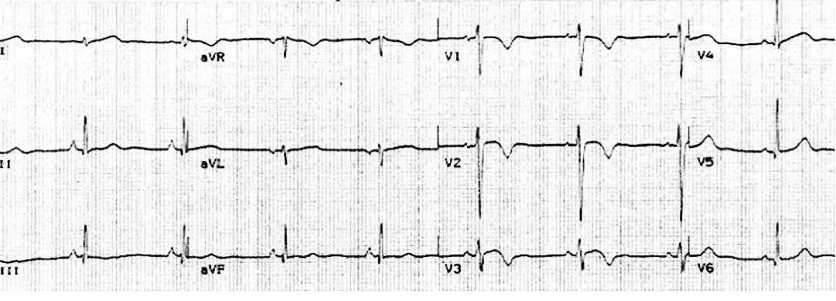
The vast majority of anterior TWI observed among healthy athletes (both Caucasian and Afro-Caribbean) was preceded by J-point elevation. This marker was never observed among patients with ARVC.
J-point elevation <1 mm and TWI extending beyond V4 showed a sensitivity for RV cardiomyopathy of 100%.
Only TWI diffuse >V4 is less helpful for differentiating
athlete’s heart from ARVC.
Anterior TWI in Athlete
Anterior TWI in ARVC

Slide 18
TWI in a ARVC patient
TWI in Afro-Caribbean athlete
G. Finocchiaro
The absence of
J-point elevation and anterior TWI in differentiating
ARVC from benign TWI in athletes is sensitive, but not specific (37%)

Slide 19
3. LOW QRS voltages: a new marker of risk ?
Obesity
Enphysema
Pericar. effusion
Amyloidosis
ARVC
Low QRS voltage

Slide 20
Consecutive, elite athletes
LOW QRS voltages: a new marker of risk ?
516
493
(96%)
23
(4%)
Normal QRS voltages
Low QRS voltages

Slide 21
Exercise testing

Slide 22
Exercise ECG
Resting ECG

Slide 23
CMR: LGE

Slide 25
12-lead ECG
Positive Family Hx
Symptoms
TWI infero-lateral
Uncommon PVCs induced by exercise
LOW
QRS voltage
In isolation
Associated
with:
Echocardiography
CMR
No CV disease
CV disease
No sport restriction
Follow-up advised
Disease management
Including sport restriction
Notes:
atleti IMSS 2005-2010: 4,962 di cui:
no indication ECG monitoring: 3,949
24h ECG monitoring: 1,013
Dei 1013:
popolazione generale di età compresa tra 15 e 50 anni senza PVCs (<50 PVCs): 441
esclusi (<15 e >50 anni/paralimpici): 367
popolazione studio: 205

Slide 26
Thank you for your attention
See also :www.antoniopelliccia.it

Slide 28
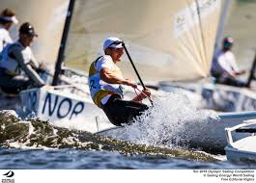
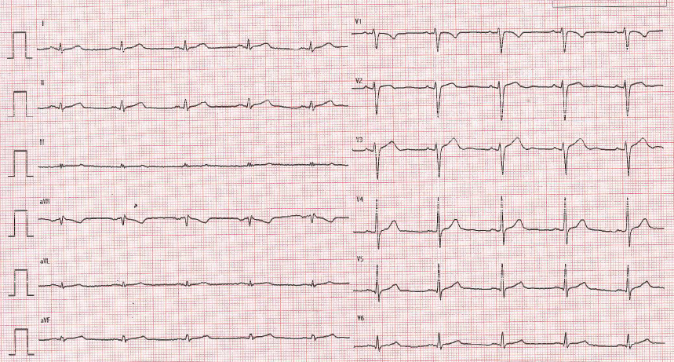
24-year asymptomatic athlete at PPS

Slide 29
TWI in the anterior precordial leads,
beyond V2, were almost confined (85%) to individuals
aged <16 years.
Over 16 years, only 2
(0.1%) male athletes exhibited TWI beyond V2

Slide 30
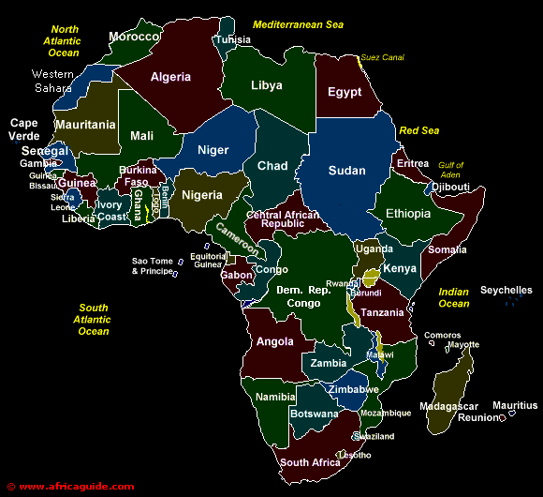
Anterior TWI: 1%
Infero-lateral TWI: 0.5%
LVWT: 9 mm
LV cavity: 54 mm
LV mass index: 82 g/m2
Anterior TWI: 2%
Infero-lateral TWI: 1.5%
Anterior TWI: 8%
Infero-lateral TWI: 5%
LVWT: 8.7 mm
LV cavity: 52 mm
LV mass index: 77 g/m2
LVWT: 9.6 mm
LV cavity: 54 mm
LV mass index: 88 g/m2

