Slide 1

How to read an Athlete’s ECG
Borderline ECG patterns

Slide 2
Borderline ECG criteria
Left axis deviation
Left atrial enlargement
Right axis deviation
Right atrial enlargement
Complete RBBB
In isolation
2 or more
No further evaluation required
in asymptomatic athletes with no family history of inherited cardiac disease or SCD
Further evaluation required
to investigate for pathologic cardiovascular disorders associated with SCD in athletes

Slide 3

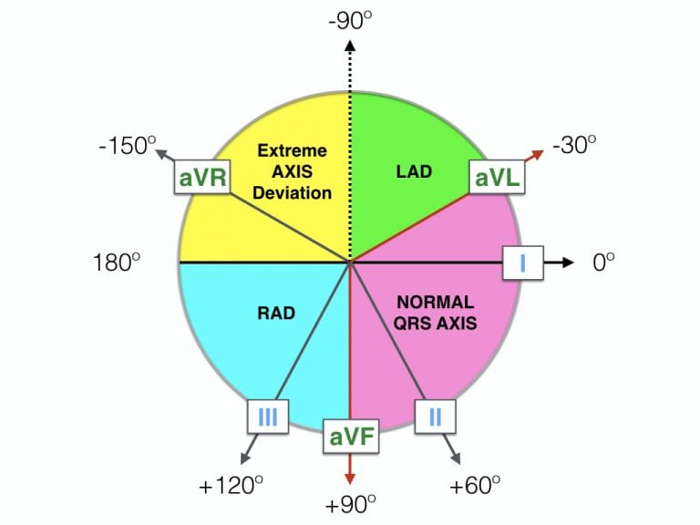


Calculating the QRS axis

Slide 4
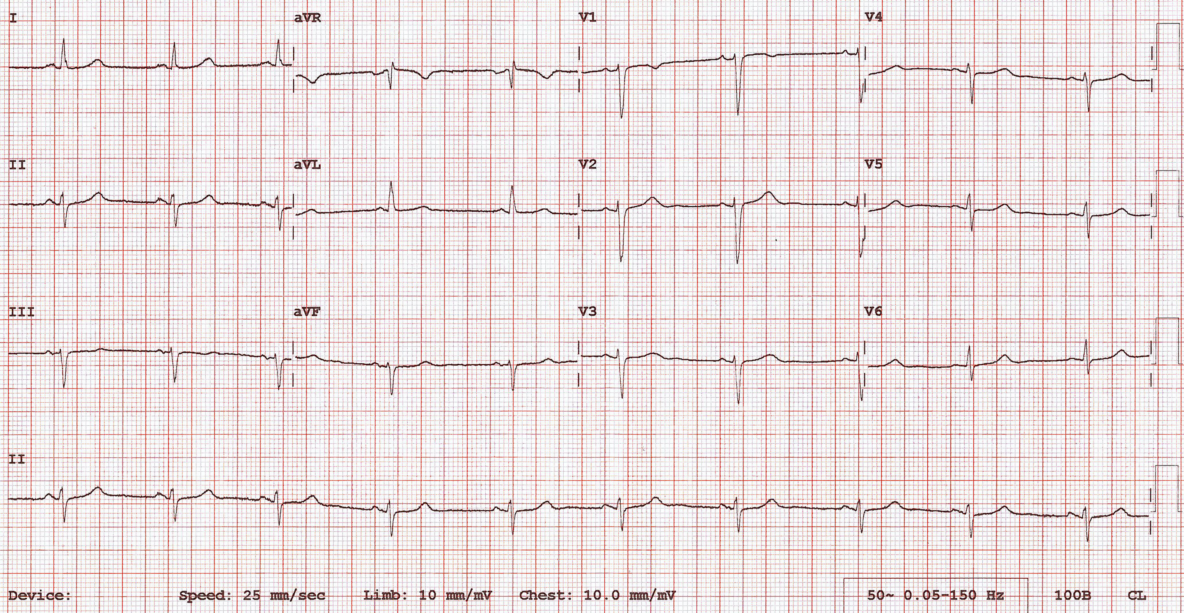
19-year-old, female, amateur runner

Slide 5
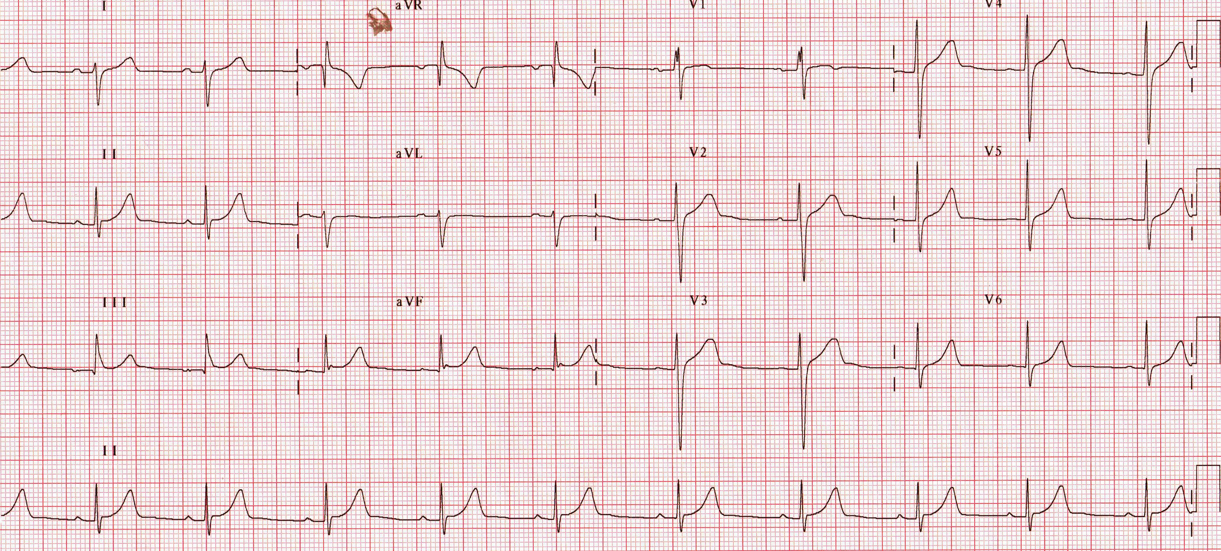
14-year-old female gymnast
Notes:
RAD

Slide 6
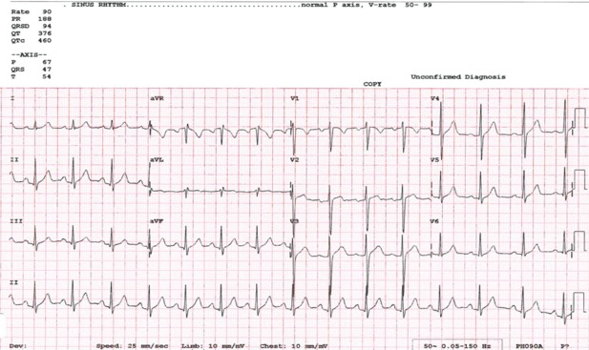
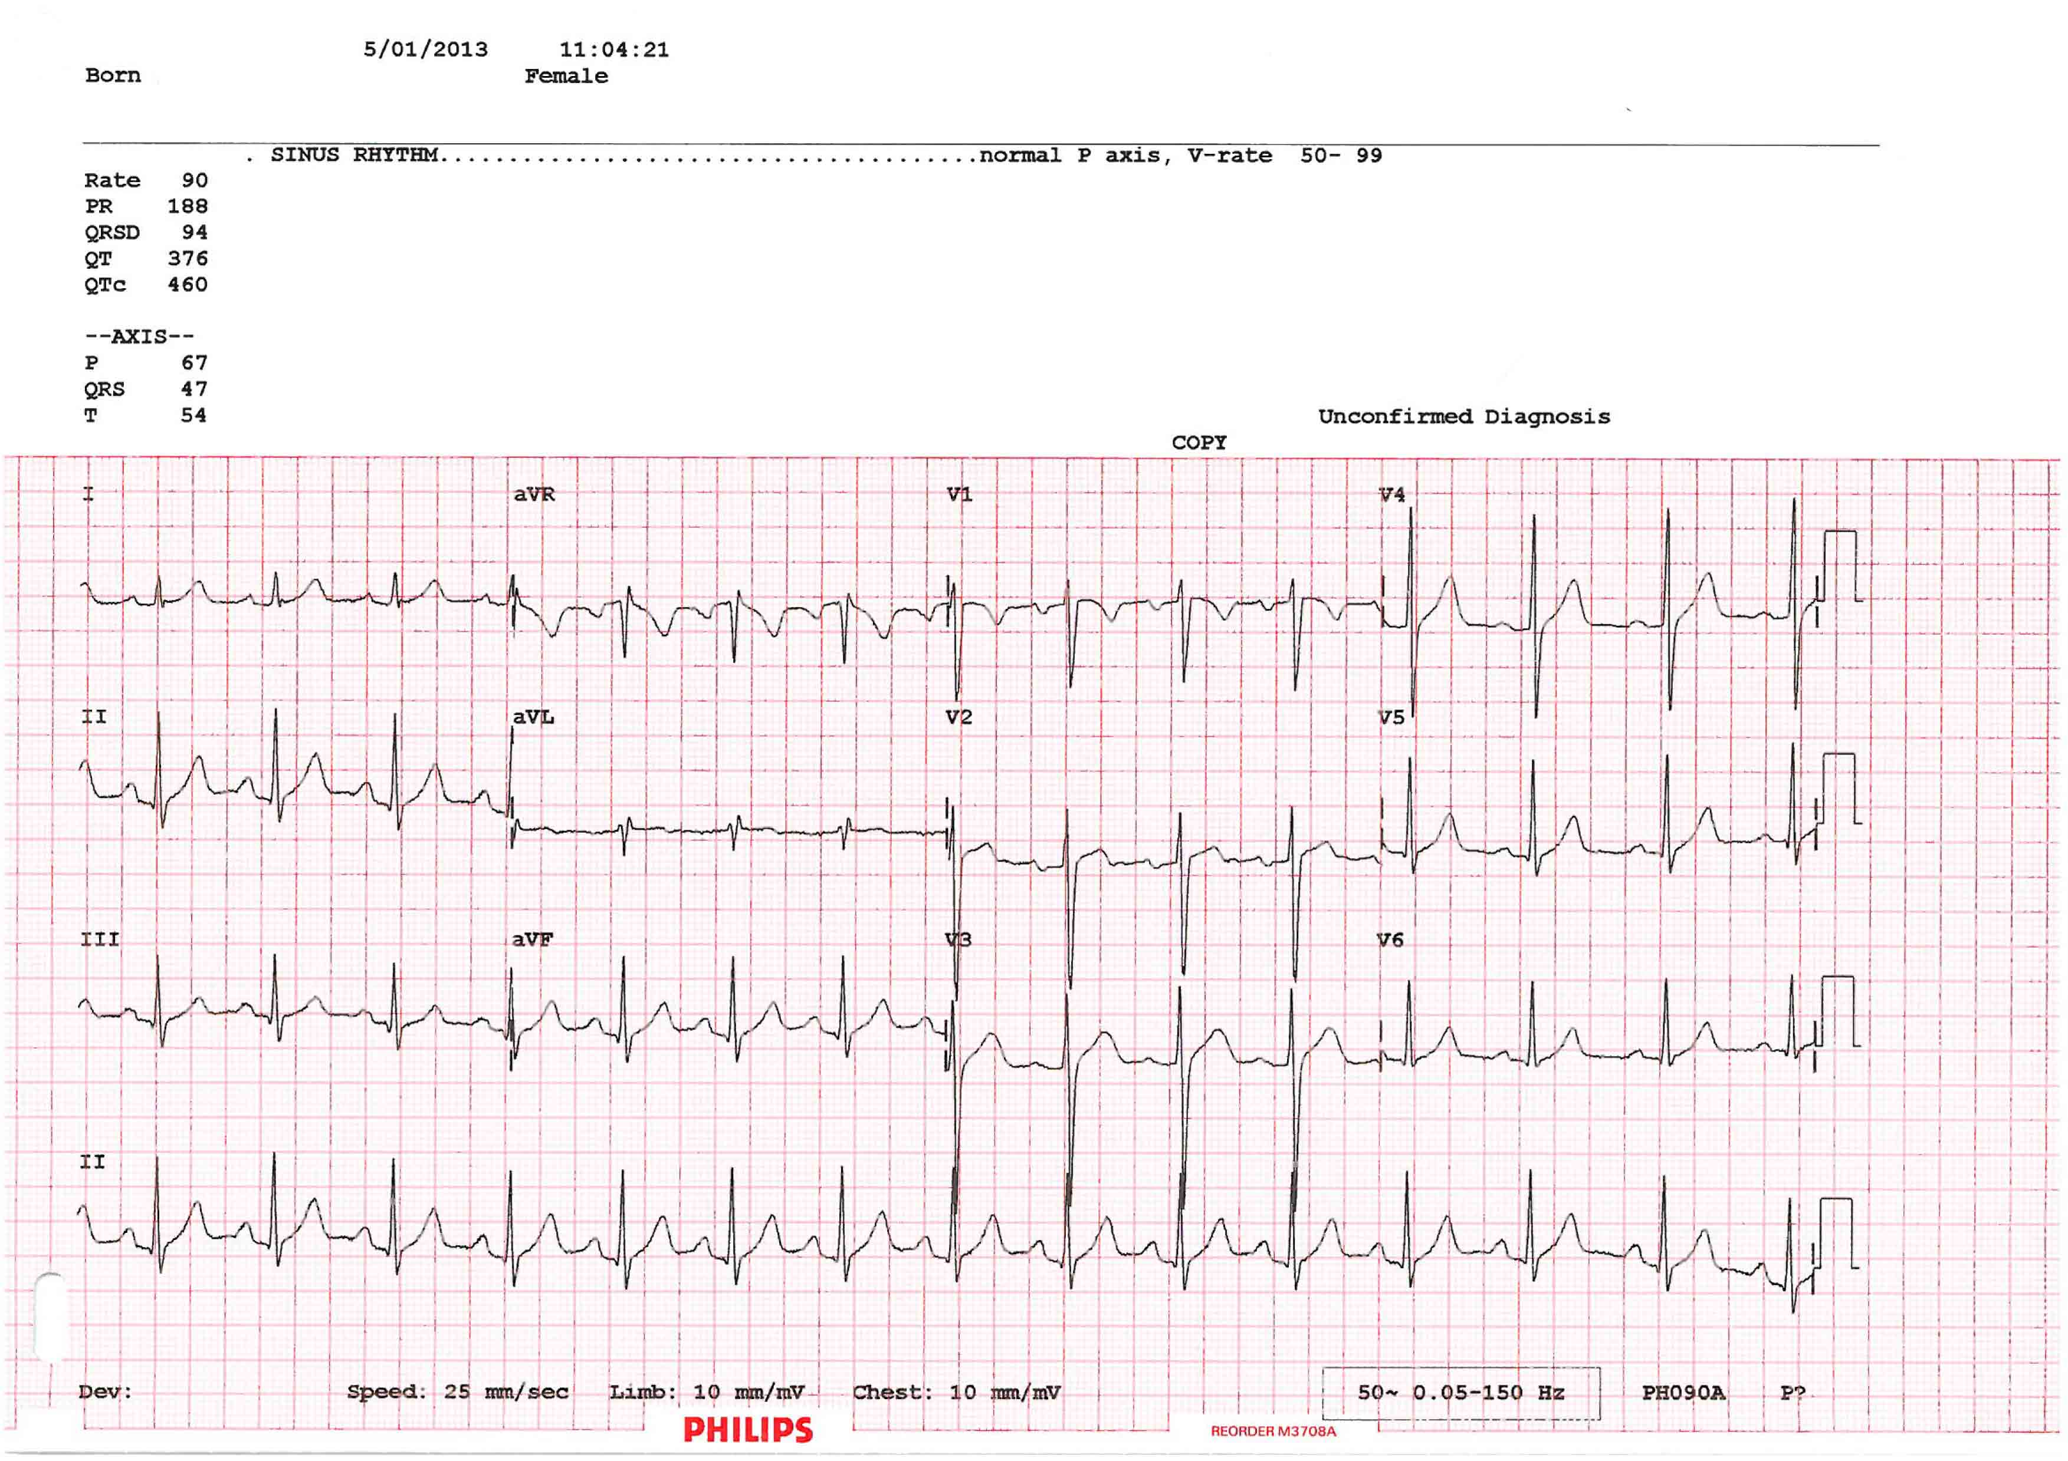
Asymptomatic young female football player
Left Atrial Enlargement: Negative portion of the P wave ≧1 mm in depth and ≧40 ms in duration in lead V1

Slide 7
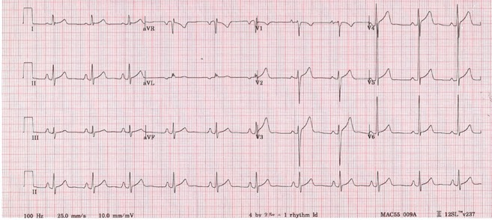
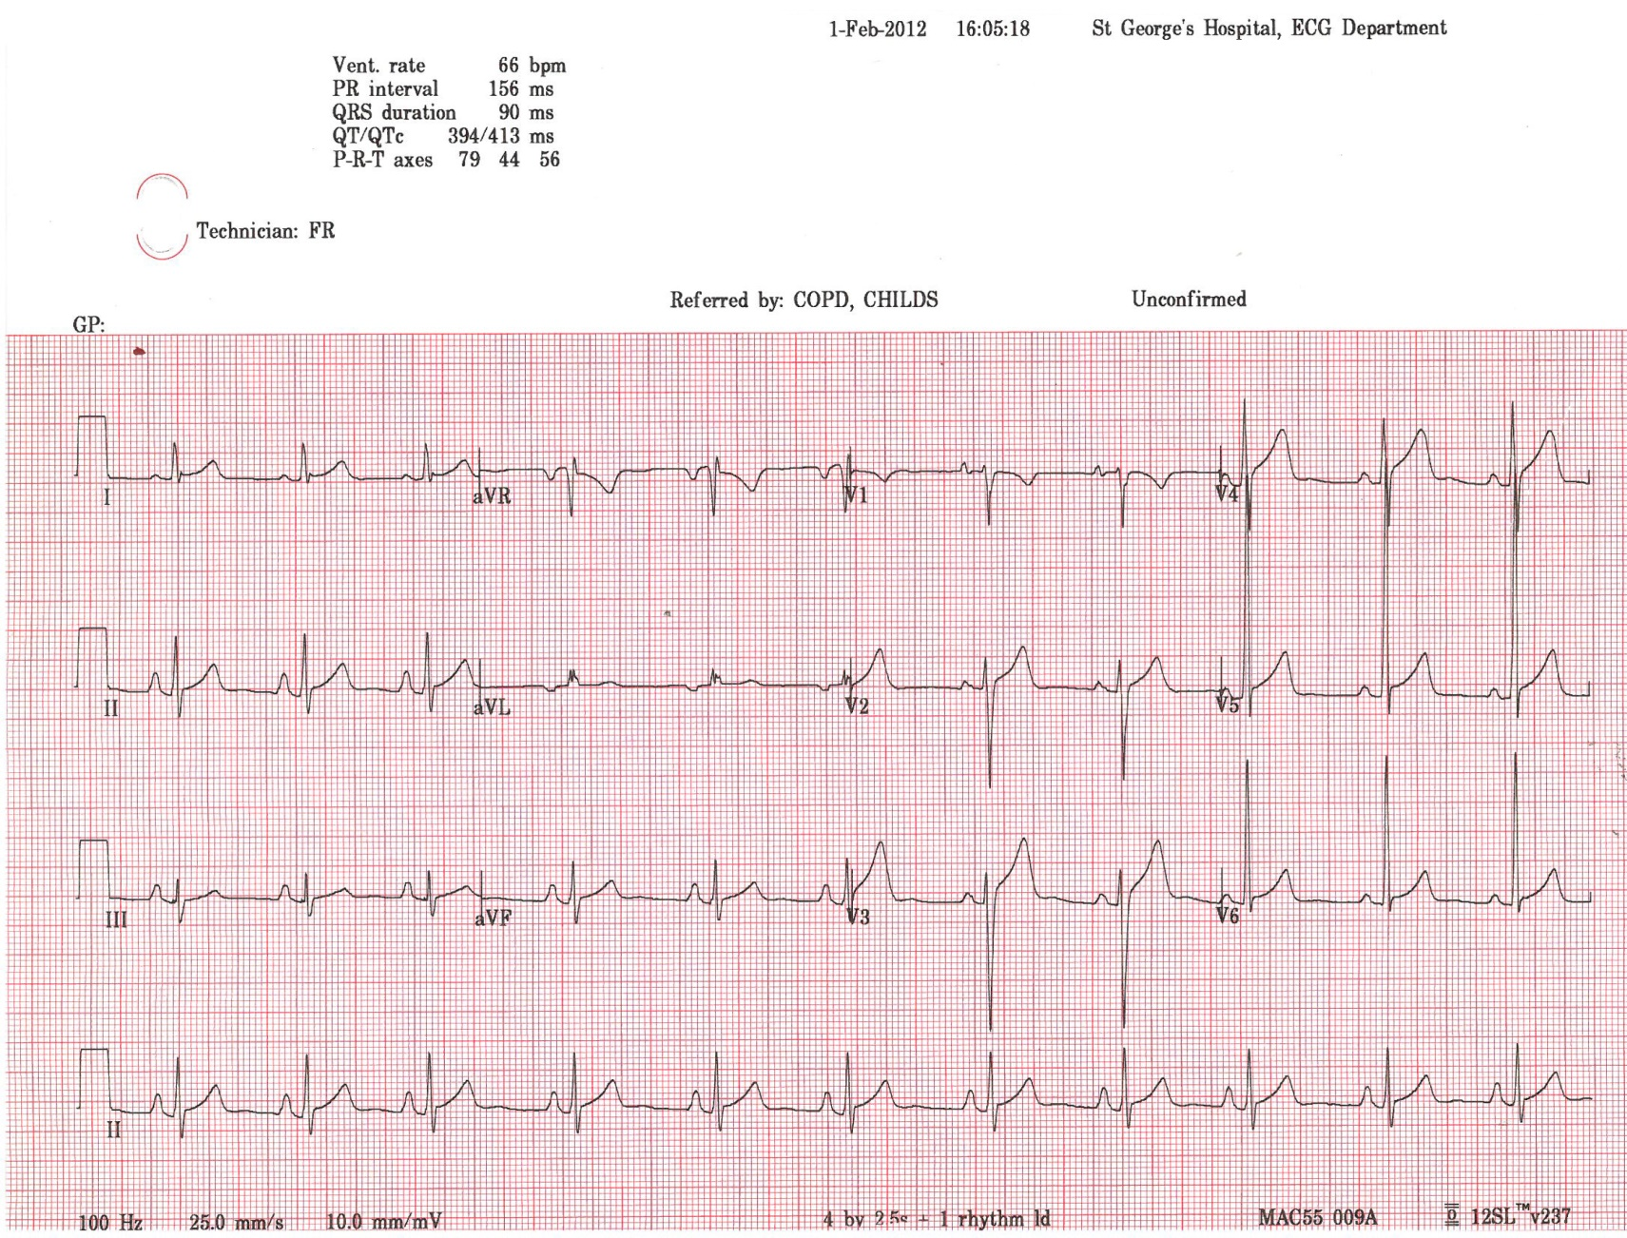
Asymptomatic male soccer player
Right Atrial Enlargement: P wave ≧ 2.5 mm in II, III, or aVF

Slide 8
Significance of atrial enlargement & axis deviation
2533 young athletes who underwent ECG and ECHO
Gati et al. Eur Heart J 2013;34:3641-3648

Slide 9
Significance of atrial enlargement & axis deviation
More frequent in athletes than controls 5.5% vs 4.4%, p=0.023
  Similar prevalence of RAE and RAD
    No echocardiographic differences btw athletes with RAE or RAD and athletes with normal ECGs
  Athletes tend to have more LAE and LAD
    Athletes with LAE or LAD had larger cavities and thicker LV compared to athletes with normal ECGs
    Male gender and more hours of training
Axis deviation or atrial enlargement in isolation
  Rarely represents pathology in young individuals
  Uncommon finding in HCM

Slide 10
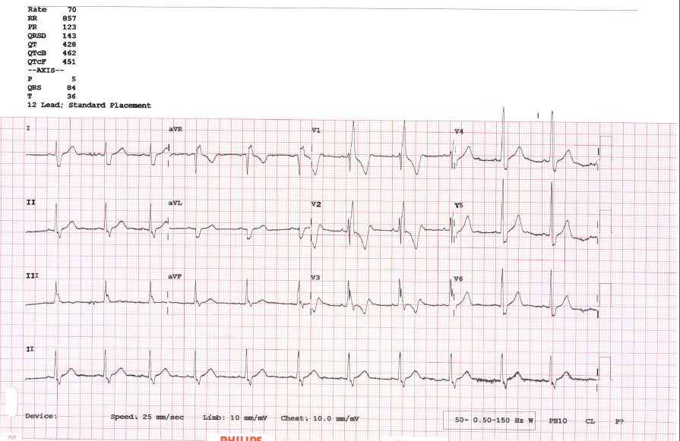
RBBB in a 17-year old elite cyclist

Slide 11
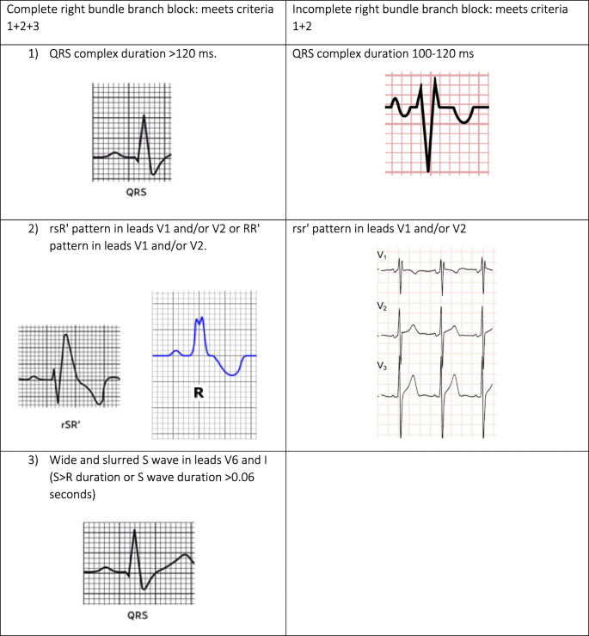

Slide 12

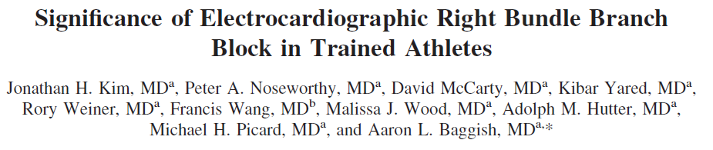
RBBB can be seen in up to 3% of athletes
Not associated with disease
Kim J et al. Am J Cardiol 2011;107:1083-1089

Slide 13
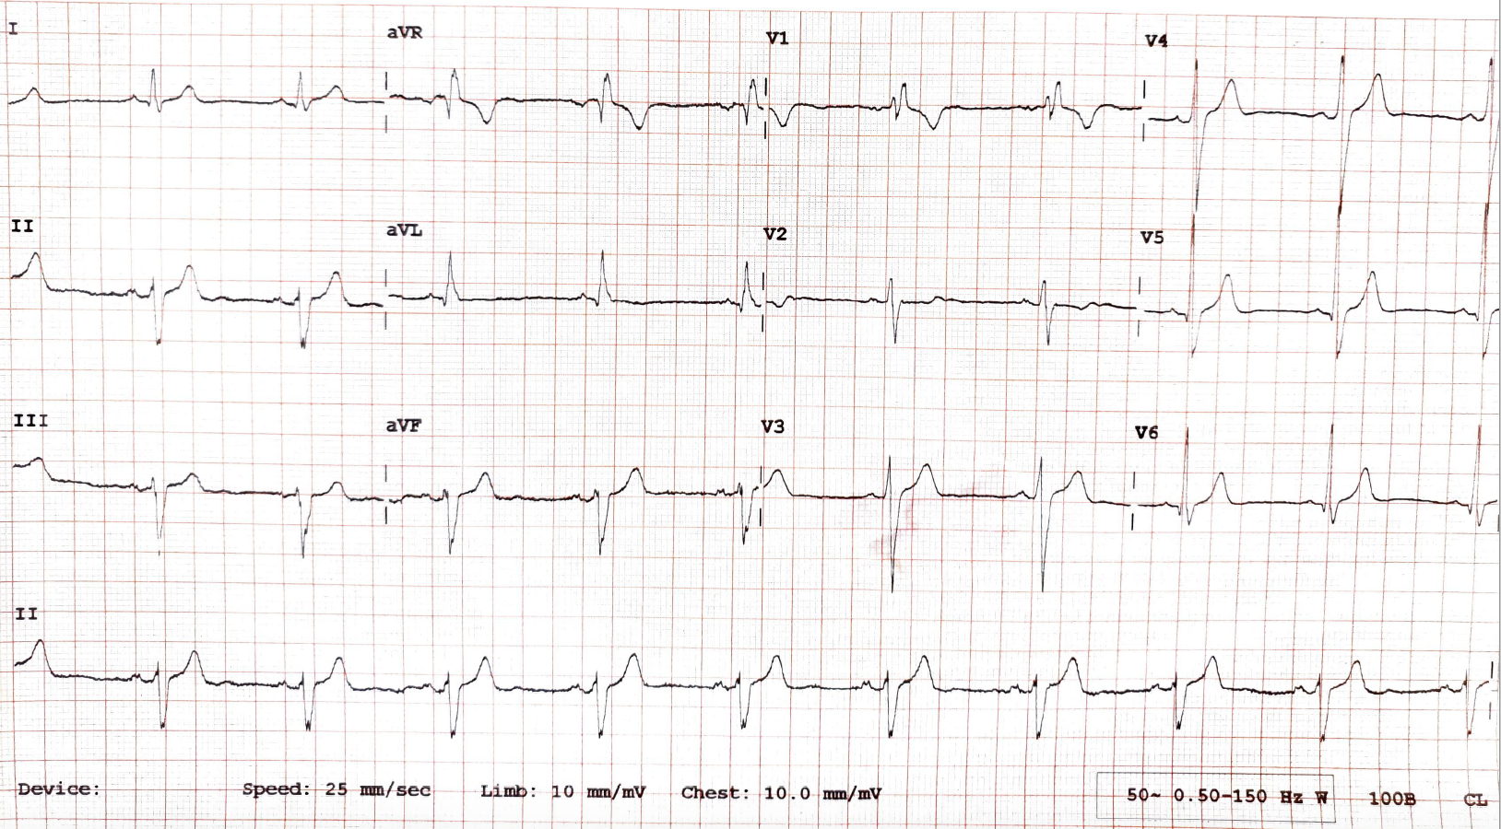
34-year-old male amateur runner on routine cardiac evaluation.
History & physical examination reported as normal.

Slide 14
Would you:
Clear the athlete, or
B. Request further evaluation?

Slide 15
Left axis deviation
Complete RBBB

Slide 16
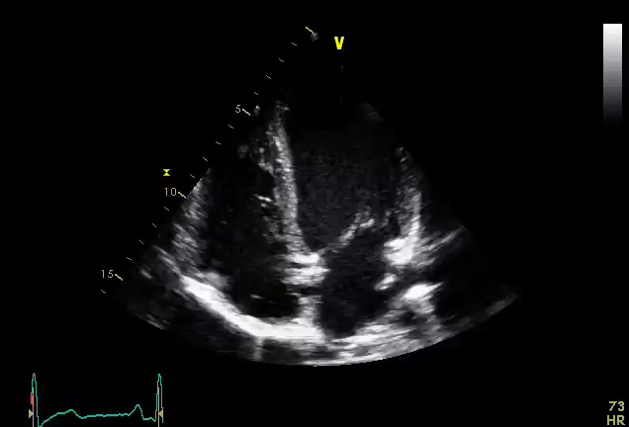
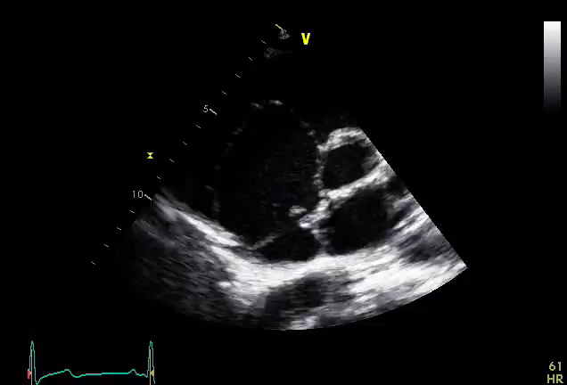
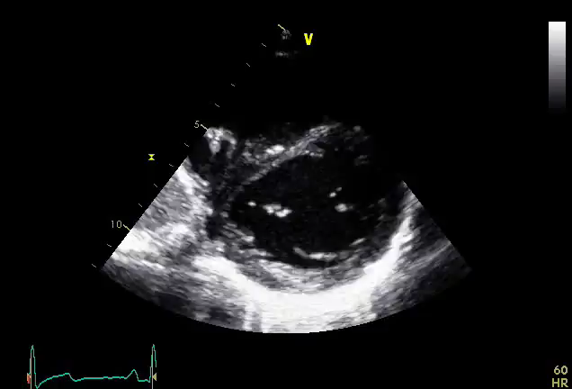
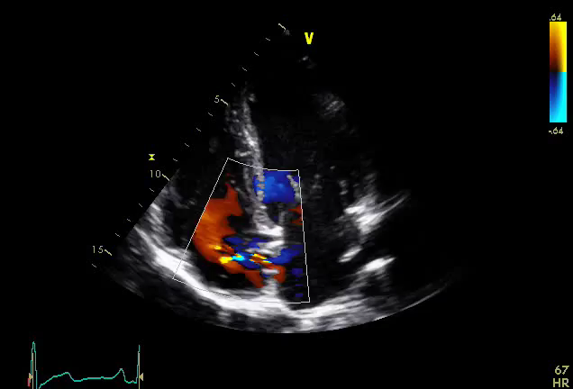
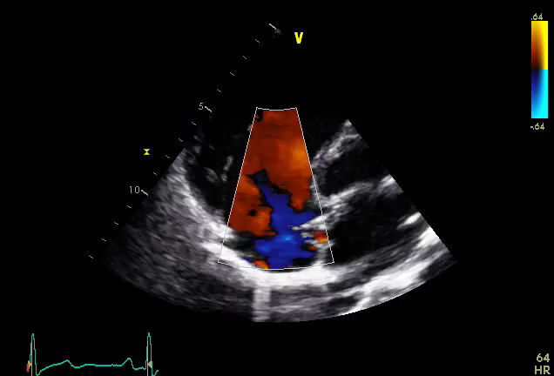
Aneurismatic atrial septum
Left to right shunt:
Atrial septal defect

Slide 17
End of the lecture 2

